Slide 1
Historic Preservation in Nebraska
The Certified Local Government Program

Slide 2
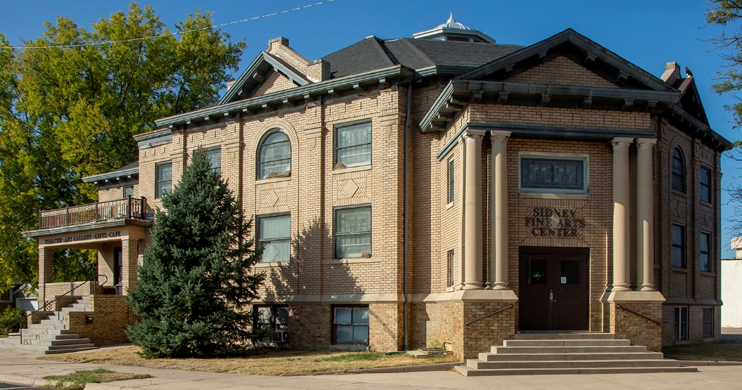
Questions to Ponder
What makes your community unique?
What are you proud of in your community?
How do you draw people to your town?
Do you have a vibrant downtown? Why/why not?
Do you have ideas to use vacant buildings?
Do you have ideas to use vacant storefronts or upper stories in commercial buildings?
Do you give tours of your town?
Do you have any buildings that are important to the community or that you love? How would you feel if they weren’t there anymore?
Do you tell the history of the people who have lived in your community?
Notes:
I want to start the presentation with some rhetorical questions.

Slide 3
Heritage Tourism
What is heritage tourism?
Traveling to experience places, artifacts, and activities that represents people and their stories (National Trust for Historic Preservation)
What are the benefits?
Heritage tourists take more time for travel, travel farther distances, and spend more money than non-heritage tourists
More memorable experiences when they learn something
Creates job, new business opportunities, strengthens local economies, protects resources, promotes community pride
Notes:
A 2014 Cultural Heritage Tourism report by Partners for Livable Communities said over 78% of travelers visited a cultural heritage attraction (historic attraction, park, art gallery/museum, concert/play/musical/festival, significant neighborhoods/communities, or ethnic heritage site). This is more than the number of people who report visiting friends or family.
A 2003 report by the Travel Industry Association of America found that for the majority of cultural heritage tourists, a specific historic or cultural activity or event was a main reason for at least one trip in the past year, and 40% of them added extra time to their trip because of an historic or cultural activity.
The Texas Historical Commission reports that 55% of Gen Zers travel to increase their knowledge and experience; 43% of Millennials travel to find themselves.

Slide 4
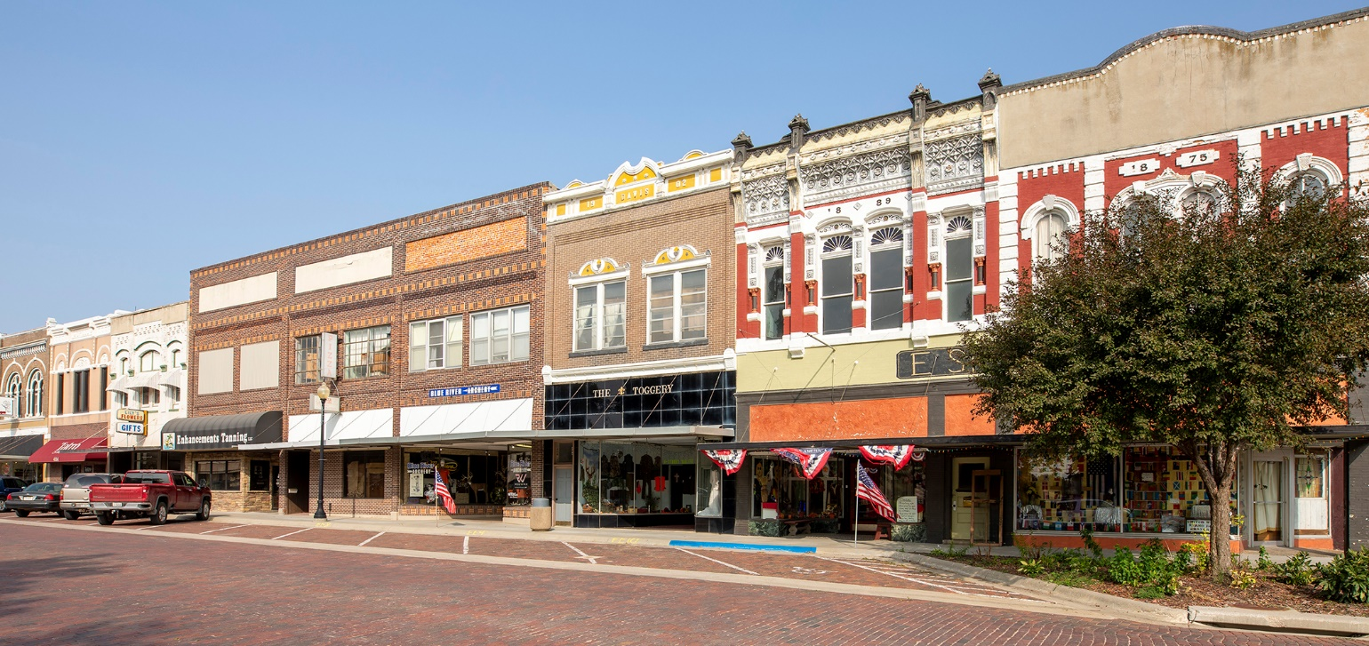
What is the Certified Local Government (CLG) program?
Historic preservation assistance program for local governments (cities/villages/counties)
Network of governments working on similar goals
Partnership between NPS, SHPO, and local government
Notes:
It brings the NPS programs down to a local government level (community or county). Preservation happens at a local level. You know which historic resources give your governments an identity and which ones are important to you.

Slide 5
What are CLG goals?
Sustain and build strong communities through historic preservation
Identify and support each community’s unique heritage
Foster community pride, economic/community development, sense of ownership, planning activities
Support Main Street revitalization, neighborhood renewal, heritage tourism, housing in historic buildings
Increase local preservation activities
Tell your community’s and your residents’ stories

Slide 6
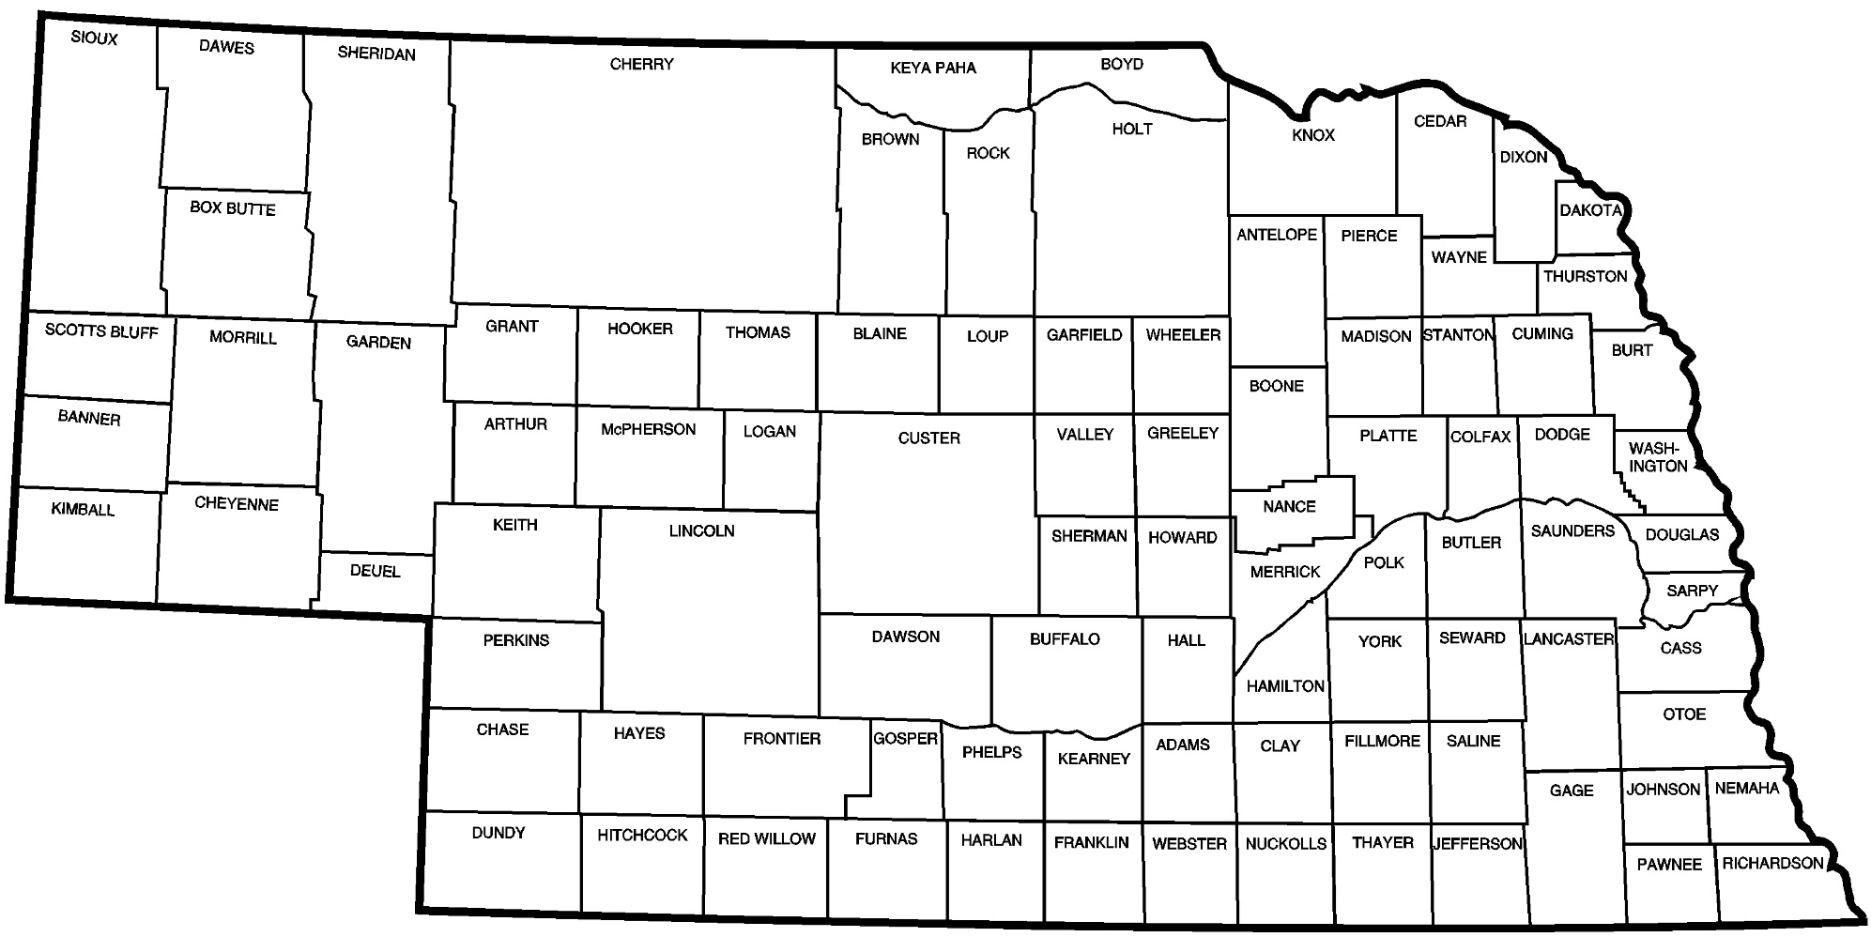
Where are the current Nebraska CLGs?
Auburn
Fairbury
Lincoln
North Platte
Omaha
Plattsmouth
Red Cloud
Sidney
Notes:
At the end of FY18 (ended Sept. 30, 2018), there were 2,020 CLGs across the country.

Slide 7
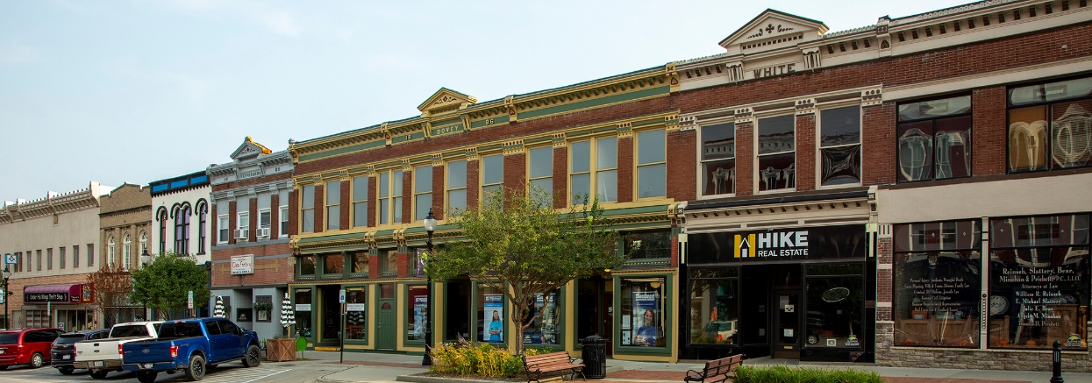
Powers and Duties as a CLG
Conduct surveys
Write National Register of Historic Places and local landmark nominations
Assist with tax incentive Part 1 applications
Comment on Review and Compliance projects
Establish design guidelines
Notes:
Surveys typically done through contractors.
NR nominations & local landmark nominations can be done through contractors.
Local landmarks
Decided by the historic preservation commission & the CLG, not the state or NPS
Made through a zoning overlay
Can landmark individual properties or districts; residential or commercial (downtown) or industrial; buildings or structures or objects (not museum objects) or sites
Should have property owner permission for individual properties or majority for districts
Part 1 of the tax incentive applications is determining if the resource is historic.
Review and Compliance can help keep community character
Process still goes through our office
Design guidelines can help keep community character
Would apply to local landmarks, but there was property owner permission for the landmarking

Slide 8
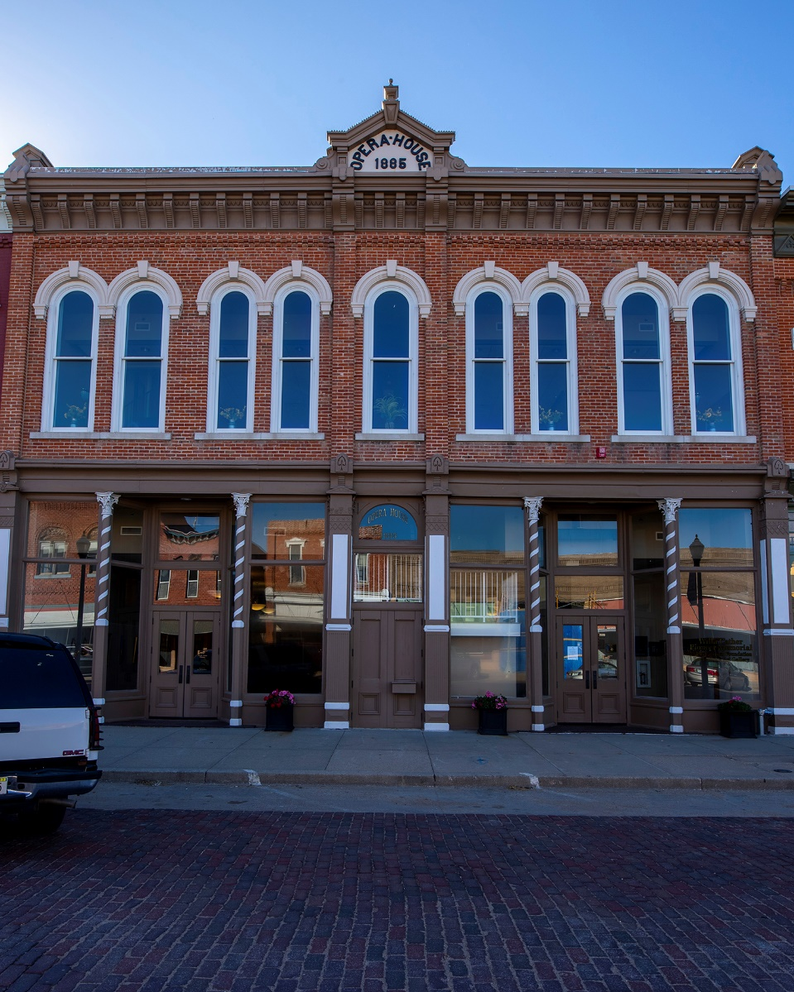
Requirements
Preservation Ordinance
Historic Preservation Commission
Survey
Public Participation/Public Education
Staff
Notes:
We have an annotated preservation ordinance for your use. It must provide for the protection of historic properties. This could be demolition review of historic resources, review of certain exterior changes. The level of authority is up to each CLG.
5+ member commission that meets at least 4x/year; members do not have to live within the government’s corporate boundaries-just need to be familiar with the historic resources
Survey doesn’t need to happen annually, hire contractors
Can host public education opportunities, but must have public, open meetings
Need someone in government or contracted with government to be my contact. Agendas and minutes from commission meetings must be held at government offices as they are official public records.

Slide 9
Benefits
Close working relationship and technical assistance from the State Historic Preservation Office
Comment on properties proposed for the National Register of Historic Places
Local landmarks may qualify properties for the Valuation Incentive Program (VIP) (and hopefully the Nebraska Historic Tax Credit (NHTC) again)
Ability to monitor and preserve structures through local landmarking
Tool for planning, zoning, and land use issues
Way to promote pride in and understanding of a community’s history
Annual sub-grants from History Nebraska/NeSHPO through HPF
Periodic grant opportunities directly from NPS
Notes:
Multiple studies conducted around the country have shown that local landmark property values stay steady or rise faster than non-historic areas during good economic times. The values also hold steady or decrease at a lower rate compared to non-historic areas when the economy isn’t as good.
Sub-grants:
competitive
60/40 match (we pay for 60%, CLG pays for 40% of project costs)
doesn’t have to be a cash match, can be in-kind (donated) services, materials, labor
SHPO must sub-grant at least 10% of its HPF apportionment to CLGs for projects of their choosing. In Nebraska that is ~$84,000, but we want to grant more. This year we could grant more than $120,000
Some NPS grant opportunities are only available to SHPOs & CLGs like African American Civil Rights Grants, Underrepresented Community Grants, and Historic Revitalization Grants

Slide 10
Eligible Grant Activities Related to Heritage Tourism
Walking/driving tour development and research
Websites about historic places
Podcasts discussing historic places
Heritage tourism brochures
Hire photographer to take pictures of historic resources for heritage tourism materials
Incorporate interpretive markers in an education program
Storymap creation and research
Oral history project focused on historic places
Broadcast local history lectures/tours on tv/online
Cemetery research lesson plans

Slide 11
Ineligible Grant Activities
Repair, rehabilitation, reconstruction, moving, acquisition of historic properties
Plans & specifications for individual properties
Landscaping, lighting, banners, markers
Collections conservation and curatorial work
Maintenance of historic properties or construction of new buildings
Cash reserves, endowments, or revolving funds
Fundraising

Slide 12
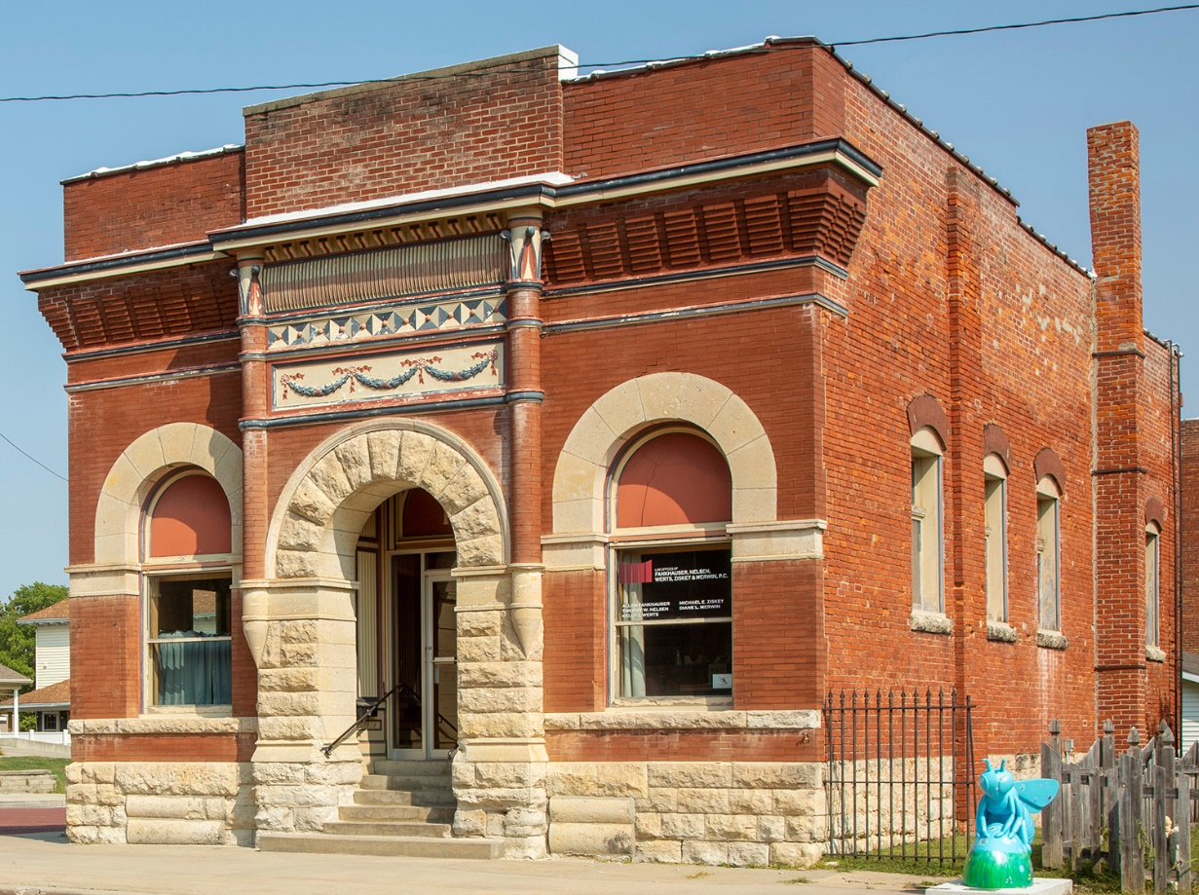
So Why Should My Local Government Become a CLG?
Promoting historic preservation efforts promotes your community, thinks long-term, creates jobs & training opportunities, maintains neighborhood character, attracts investments, conserves resources, tells the stories of your community & your people…

Slide 13
Contact Me
Kelli Bacon
Certified Local Government coordinator / Outreach coordinator
kelli.bacon@nebraska.gov
402-540-5847

