Slide 1
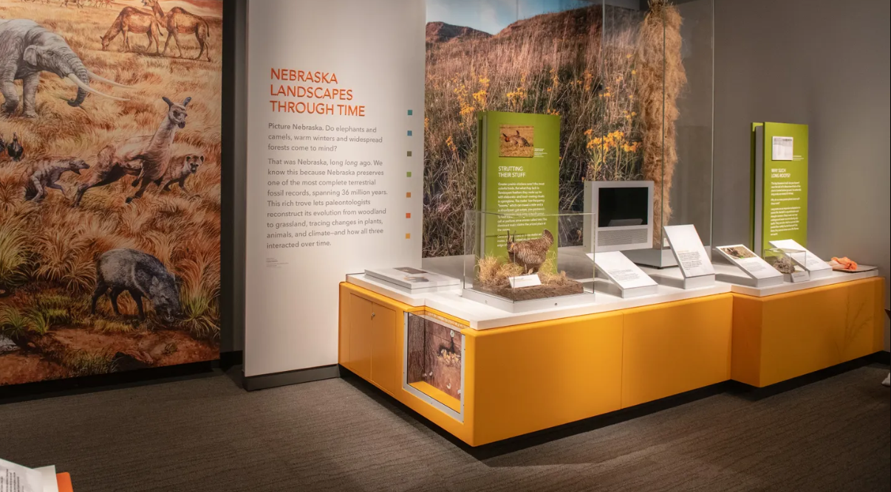
History without Meaning Just Isn’t Worth Doing
How to Apply Historical Interpretation at Museums and Historic Sites
Photo credit: University of Nebraska State Museum, “Cherish Nebraska” Exhibit, 2019

Slide 2
What is
Historical Interpretation?
Notes:
Can be a very overwhelming and hard to “pin down” idea
Seems vague
Hopefully you’ll realize that you’re already doing it in a way, I’m here to help bring it into focus

Slide 4
Interpretation:
noun: the act or result of explaining or interpreting something; the way something is explained or understood

Slide 5
Interpretation:
noun: the act or result of explaining or interpreting something; the way something is explained or understood
Historical:
adjective: of or concerning history; concerning past events

Slide 6
Historical Interpretation:

Slide 7
Historical Interpretation:
The act or result of explaining or interpreting history; the way the past is explained or understood.
Notes:
A noun on its own – this is WHAT it is

Slide 8
Historical Interpretation:
The act or result of explaining or interpreting history; the way the past is explained or understood.
For museums and historic sites --
Creating meaningful histories from our collections and research, and effectively communicating those histories to our visitors.
Notes:
BUT- Our definition is a VERB – meaning its always “in action” changing, etc.

Slide 9
So… what’s the point?

Slide 10
Historical Interpretation Provides:
Meaning – the “why”
Notes:
Probably all of our favorite part about History ☺
Why should your visitors care about whatever you’re presenting?

Slide 11
Historical Interpretation Provides:
Meaning – the “why”
Multiple Perspectives
Notes:
More inclusive history, gets people thinking

Slide 12
Historical Interpretation Provides:
Meaning – the “why”
Multiple Perspectives
Context
Notes:
LOVE me some context

Slide 13
Historical Interpretation Provides:
Meaning – the “why”
Multiple Perspectives
Context
Stories, Storytelling, Drama
Notes:
We all love a great story- it’s why we watch TV series, movies, read books, etc.
Humor, drama, twists, surprises, learning something new

Slide 14
Historical Interpretation Provides:
Meaning – the “why”
Multiple Perspectives
Context
Stories, Storytelling, Drama
Living History
Notes:
Stories and context (descriptions) bring the history alive.
The closest we can get to actually experiencing it firsthand.

Slide 15
Historical Interpretation Provides:
Meaning – the “why”
Multiple Perspectives
Context
Stories, Storytelling, Drama
Living History
Emotional connections
Notes:
Stories lead to emotional connections – we’ve all loved or hated a fictional character we’ll never meet, or a place we’ve heard about but never been there- we can do the same thing with the histories at our museums.
Emotional connections ALWAYS hit deeper and have a longer lasting impact than intellectual ones.

Slide 16
Historical Interpretation Provides:
Meaning – the “why”
Multiple Perspectives
Context
Stories, Storytelling, Drama
Living History
Emotional connections
Visitor Connection
Notes:
When your visitors connect- they CARE.
If they feel a connection, they will make a personal connection- which is the best kind as it IS personal and individual.
If they connect – they will REMEMBER and tell other people

Slide 17
Historical Interpretation Provides:
Meaning – the “why”
Multiple Perspectives
Context
Stories, Storytelling, Drama
Living History
Emotional connections
Visitor Connection
Deeper appreciations and understandings
Notes:
overall, larger goal – have history stay with people, have them remember it

Slide 18
Early Museums
Notes:
In order to really appreciate and understand historical interpretation itself = we need to historically interpret the history of historical interpretation LOL
Basically- as with any subject, looking at its development over times gives us a better appreciation and context.

Slide 19
Notes:
First museums

Slide 20
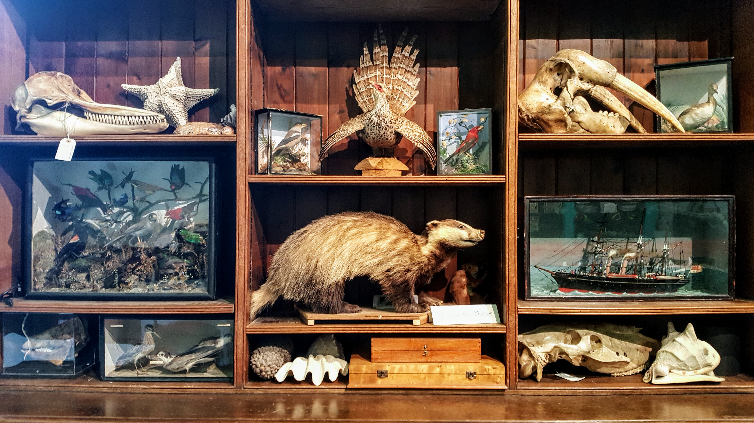
Curiosity Cabinet

Slide 21
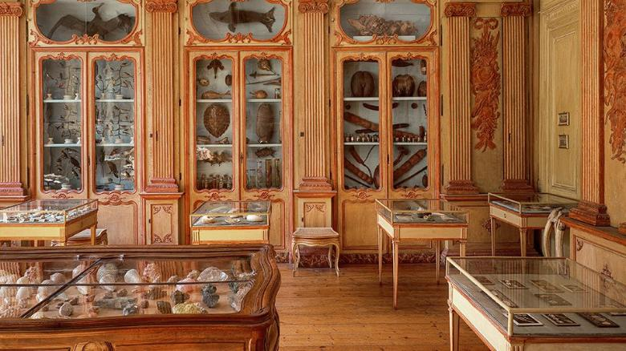
Cabinet of Curiosities
Notes:
Some grew larger - Albert Brooking- Hastings Museum example
Still around today…

Slide 22
Curio Cabinet
Notes:
We know them as “curio cabinets”

Slide 23
Notes:
Laid groundwork for first public-style museums

Slide 24
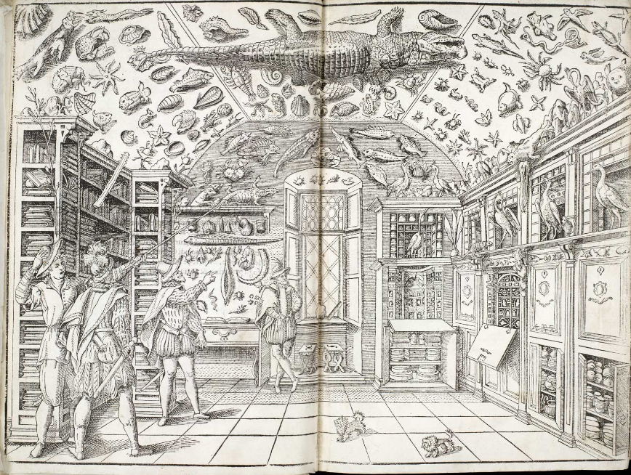
Notes:
Collectors would invite people to visit their massive cabinets

Slide 25
Illustration of Italian Apothecary Ferrante Imperato’s “Cabinet of Wonders”(1599),
likely the earliest illustration of a natural history cabinet
Notes:
In order to really appreciate and understand historical interpretation itself = we need to historically interpret the history of historical interpretation LOL
Basically- as with any subject, looking at its development over times gives us a better appreciation and context.

Slide 26
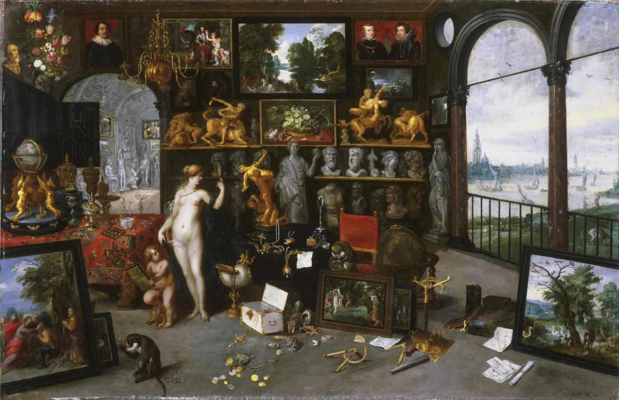

Slide 27
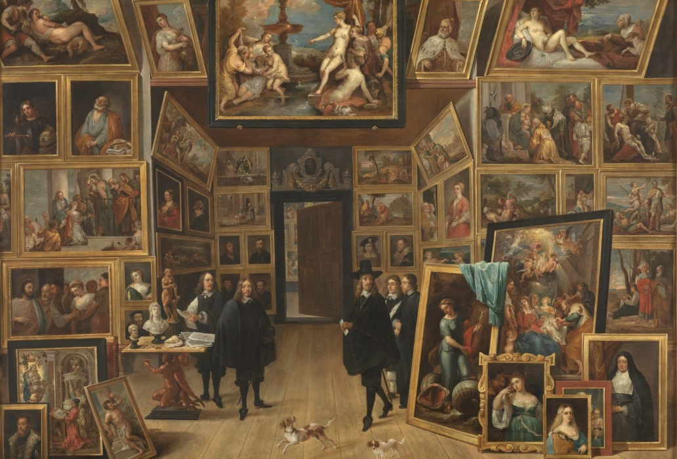

Slide 28
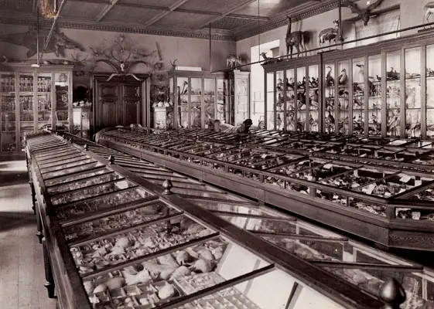
Notes:
Thompson’s Natural History Museum c. 1900

Slide 29
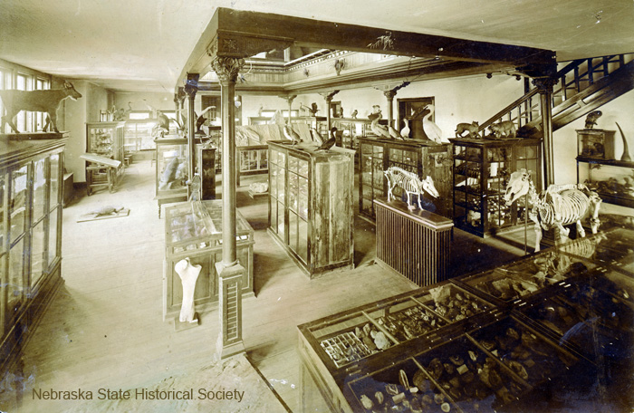
Notes:
This one’s still around today- anyone want to take a guess?

Slide 30
Morrill Hall @UNL, Present Day
Notes:
This one’s still around today- anyone want to take a guess?
Morrill Hall at UNL

Slide 31
Notes:
these early museums are important because they lay the groundwork – none of us would be here today without these
They also saved many objects that otherwise may have been lost or thrown out
Also brought the idea of “artifacts” into public knowledge

Slide 32
What’s the Drawback?
Notes:
That all sounds great, so what’s the problem?

Slide 33
Zero Historical Interpretation
Notes:
No context, no story- also completely overwhelming

Slide 34
Notes:
This offers no context, no information- no real reason why anyone would care beyond the initial impression
Ferrante Imperato

Slide 35
Notes:
Thompson’s Natural History Museum c. 1900
Completely overwhelming

Slide 36
Notes:
In the mid-1900s, museum exhibits began to change
One of the best examples of this transition is the “Treasures of the Tsars”

Slide 37
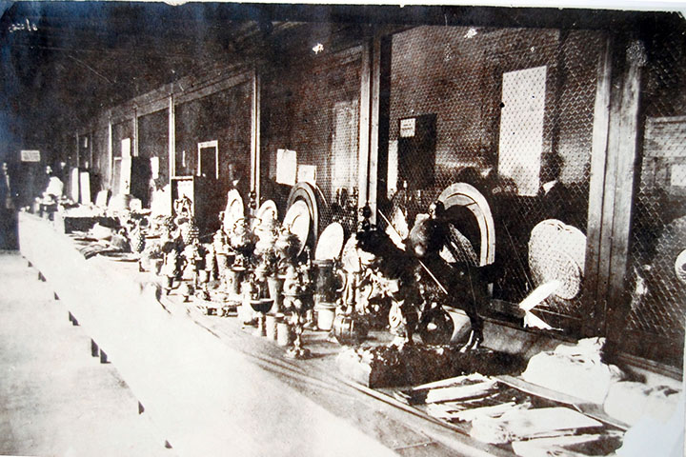
Notes:
In the mid-1900s, museum exhibits began to change
One of the best examples of this transition is the “Treasures of the Tsars”

Slide 38
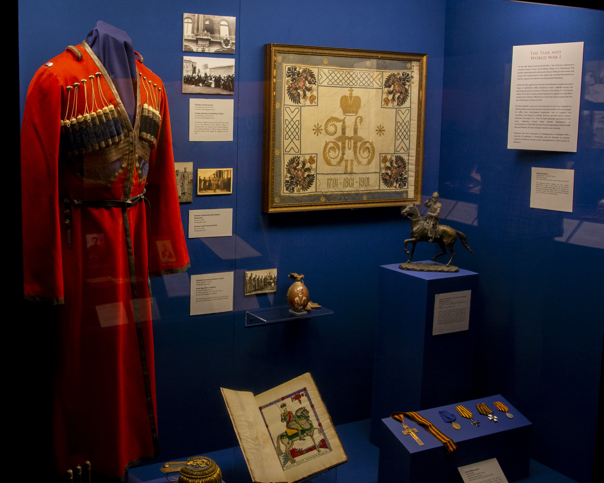
Notes:
In the 1900s, museum exhibits began to change
One of the best examples of this transition is the “Treasures of the Tsars”

Slide 39
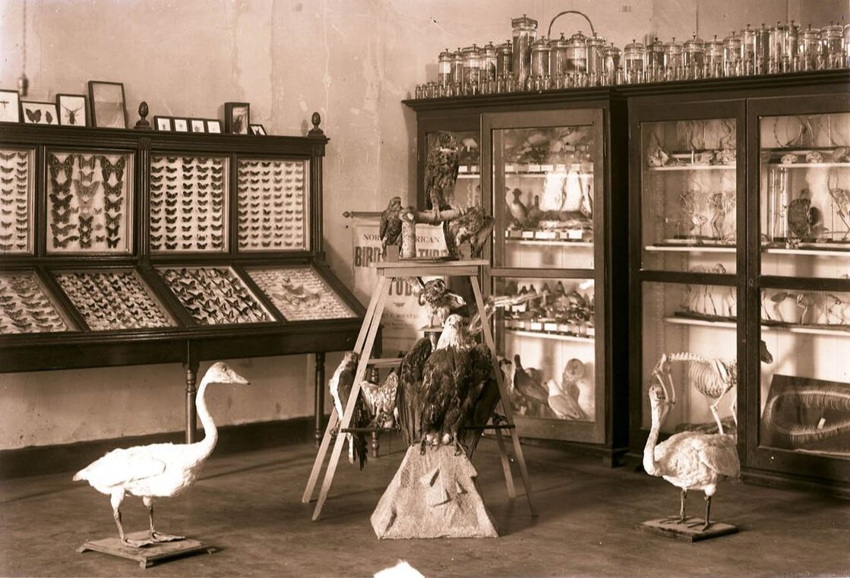
Notes:
Presenting subjects in different ways

Slide 40
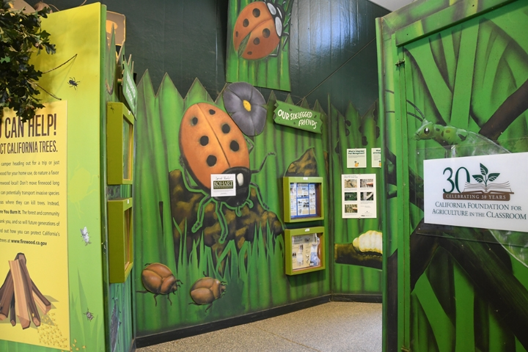
Notes:
Presenting subjects in different ways

Slide 41
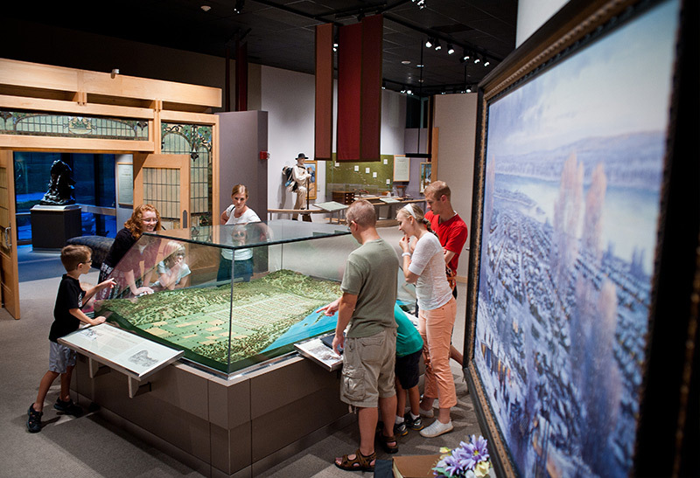
Mormon Trail Center at Winter Quarters, Omaha
Notes:
Museums today aim to be much more dynamic – including more than just a collection of stuff
They offer historical interpretation through a variety of mediums in order to provide the best visitor experiences possible

Slide 42
Applying
Historical Interpretation
Notes:
So now the question- once you know what it is and why its important, how can you easily apply historical interpretation at your institution?

Slide 43
Historical Interpretation: The Basics
Plan, Organize, and Implement

Slide 44
Historical Interpretation: The Basics
Plan, Organize, and Implement
Questions to Ask:
Why are you doing this project? What’s the purpose
What do you hope people will get from this project?
What message are you trying to convey?
Notes:
Because that’s what you’re going to want to communicate

Slide 45
Historical Interpretation: The Basics
Plan, Organize, and Implement
Questions to Ask:
Why are you doing this project? What’s the purpose
What do you hope people will get from this project?
What message are you trying to convey?
Always keep in mind: the historical significance
Notes:
Because that’s what you’re going to want to communicate

Slide 46
Getting Started: Identify the Subject Focus

Slide 47
Getting Started: Identify the Subject Focus
Who/what is the subject- the topic, event, idea, person, or group?

Slide 48
Getting Started: Identify the Subject Focus
Who/what is the subject- the topic, event, idea, person, or group?
Are there new perspectives with the subject?

Slide 49
Getting Started: Identify the Subject Focus
Who/what is the subject- the topic, event, idea, person, or group?
Are there new perspectives with the subject?
Trust your instincts – if you think its interesting, others will, too

Slide 50
Getting Started: Identify the Subject Focus
Who/what is the subject- the topic, event, idea, person, or group?
Are there new perspectives with the subject?
Trust your instincts – if you think its interesting, others will, too
After subject is identified, start collecting responsible, vetted research
Notes:
Primary sources, first-person accounts, people from that community, experts

Slide 51
Getting Started: Research
Notes:
Primary sources, first-person accounts, people from that community, experts

Slide 52
Getting Started: Research
Responsible, vetted research
Look for primary sources – newspapers, oral histories, diaries, letters
Look for the interesting parts, the “story”
Trust your instincts – if you think its interesting, others will, too
Notes:
Primary sources, first-person accounts, people from that community, experts

Slide 53
What will the finished project look like?
Notes:
As you research and hone down your focus, start thinking about what the project will look like

Slide 54
What will the finished project look like?
Exhibit
Paper or Article
Webinar Series
Documentary
In-Person Event
Social Media Campaign
Notes:
Or something else?
Different medias work differently and are ABSORBED (interpreted) differently by audiences

Slide 55
Getting Started: Consider your Audience

Slide 56
Getting Started: Consider your Audience
Who is this project for?
Ages, Demographic, Culture
Don’t Forget your Local Community – Tie them In
Remember – we all perceive things differently
Notes:
Purple square example

Slide 57
Getting Started: Consider your Audience
Who is this project for?
Ages, Demographic, Culture
Don’t Forget your Local Community – Tie them In
Remember – we all perceive things differently
Accessibility
Notes:
accessibility – ADA for all forms of media- in person, online

Slide 58
Getting Started: Consider your Audience
Who is this project for?
Ages, Demographic, Culture
Don’t Forget your Local Community – Tie them In
Remember – we all perceive things differently
Accessibility
Avoid Museum Fatigue
Notes:
How to relay a full interpreted message in a short amount of time or space?

Slide 59
Selecting Materials for Interpretation Variety
Notes:
How to relay a full interpreted message in a short amount of time or space?

Slide 60
Selecting Materials for Interpretation Variety
A variety of materials provides more comprehensive historical interpretation.
Notes:
Depending on the final project form- what should you include

Slide 61
Selecting Materials for Interpretation Variety
A variety of materials provides more comprehensive historical interpretation.
Artifacts
Text
Photos
Tour Guide Script
Interactives
Notes:
Artifacts- spacial, tactile- living piece of history
Text- the info
Photos – helps imagery, picturing the history

Slide 62
Demonstration Time!
Historically Interpreting Artifacts
Notes:
Use 3 artifacts for interpretation demonstration
20 Questions to ask an artifact – if you do it correctly, objects will almost develop their own individual personalities.
I talk to the objects at my museum
Think of an object from your past that means something to you- why?

Slide 63
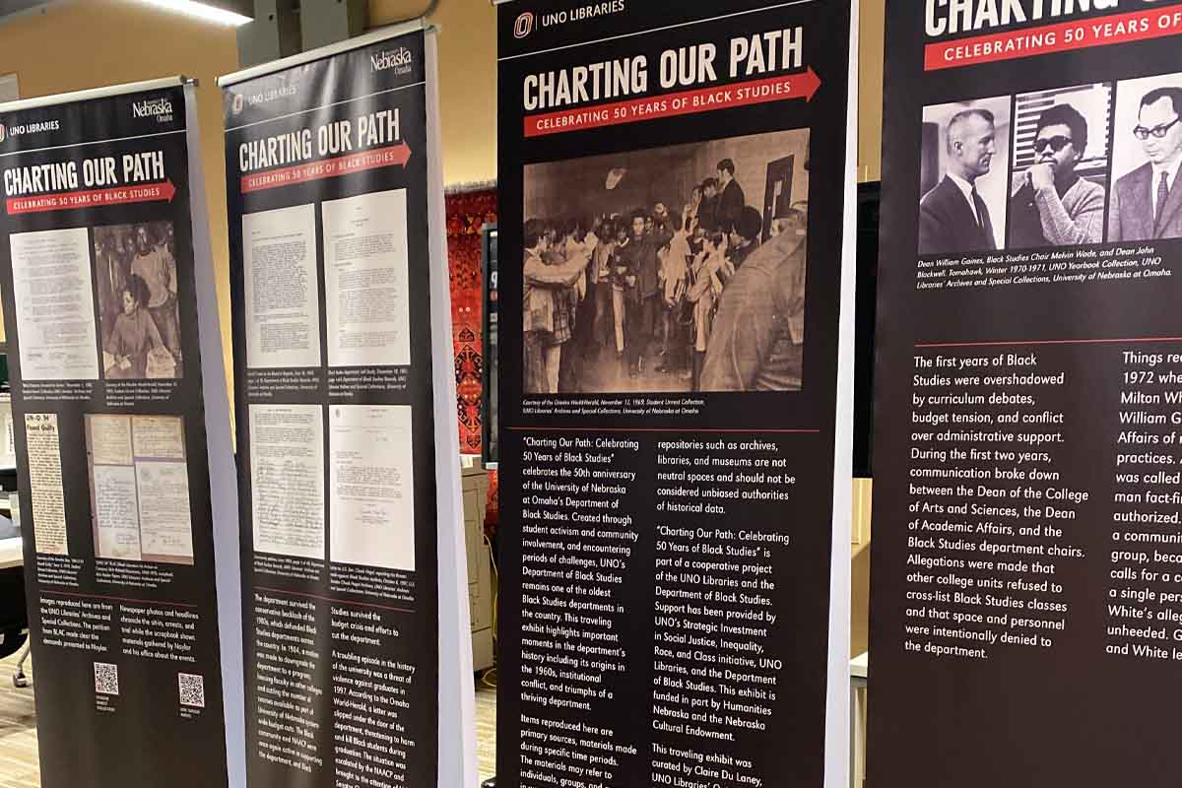
Notes:
Along with artifacts- text, photos

Slide 64
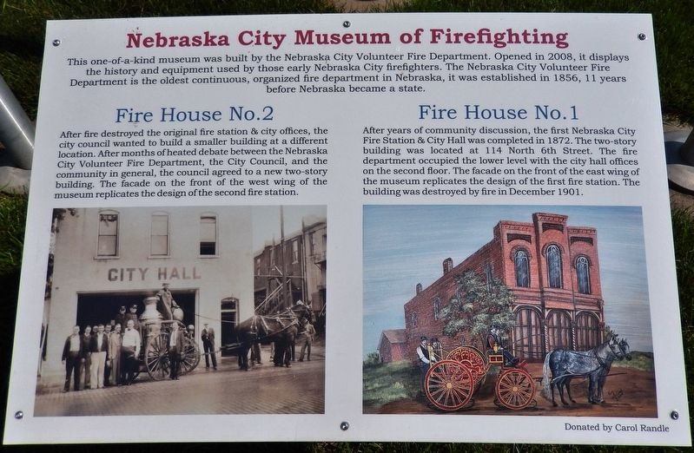

Slide 65
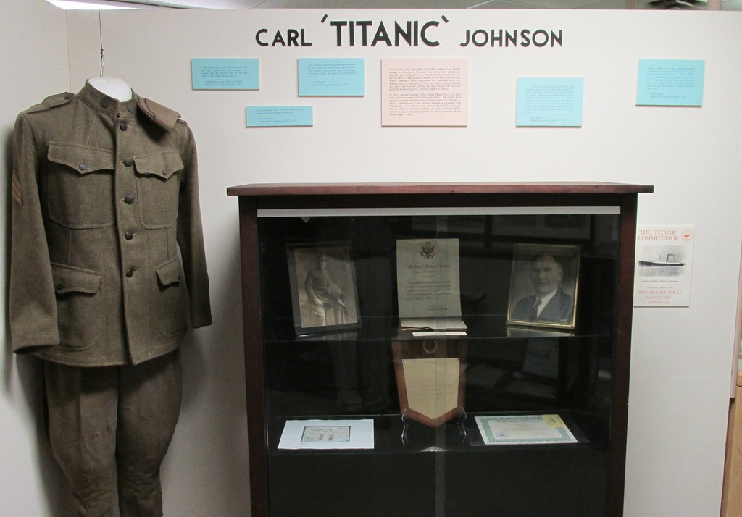
Notes:
Saunders county museum

Slide 66
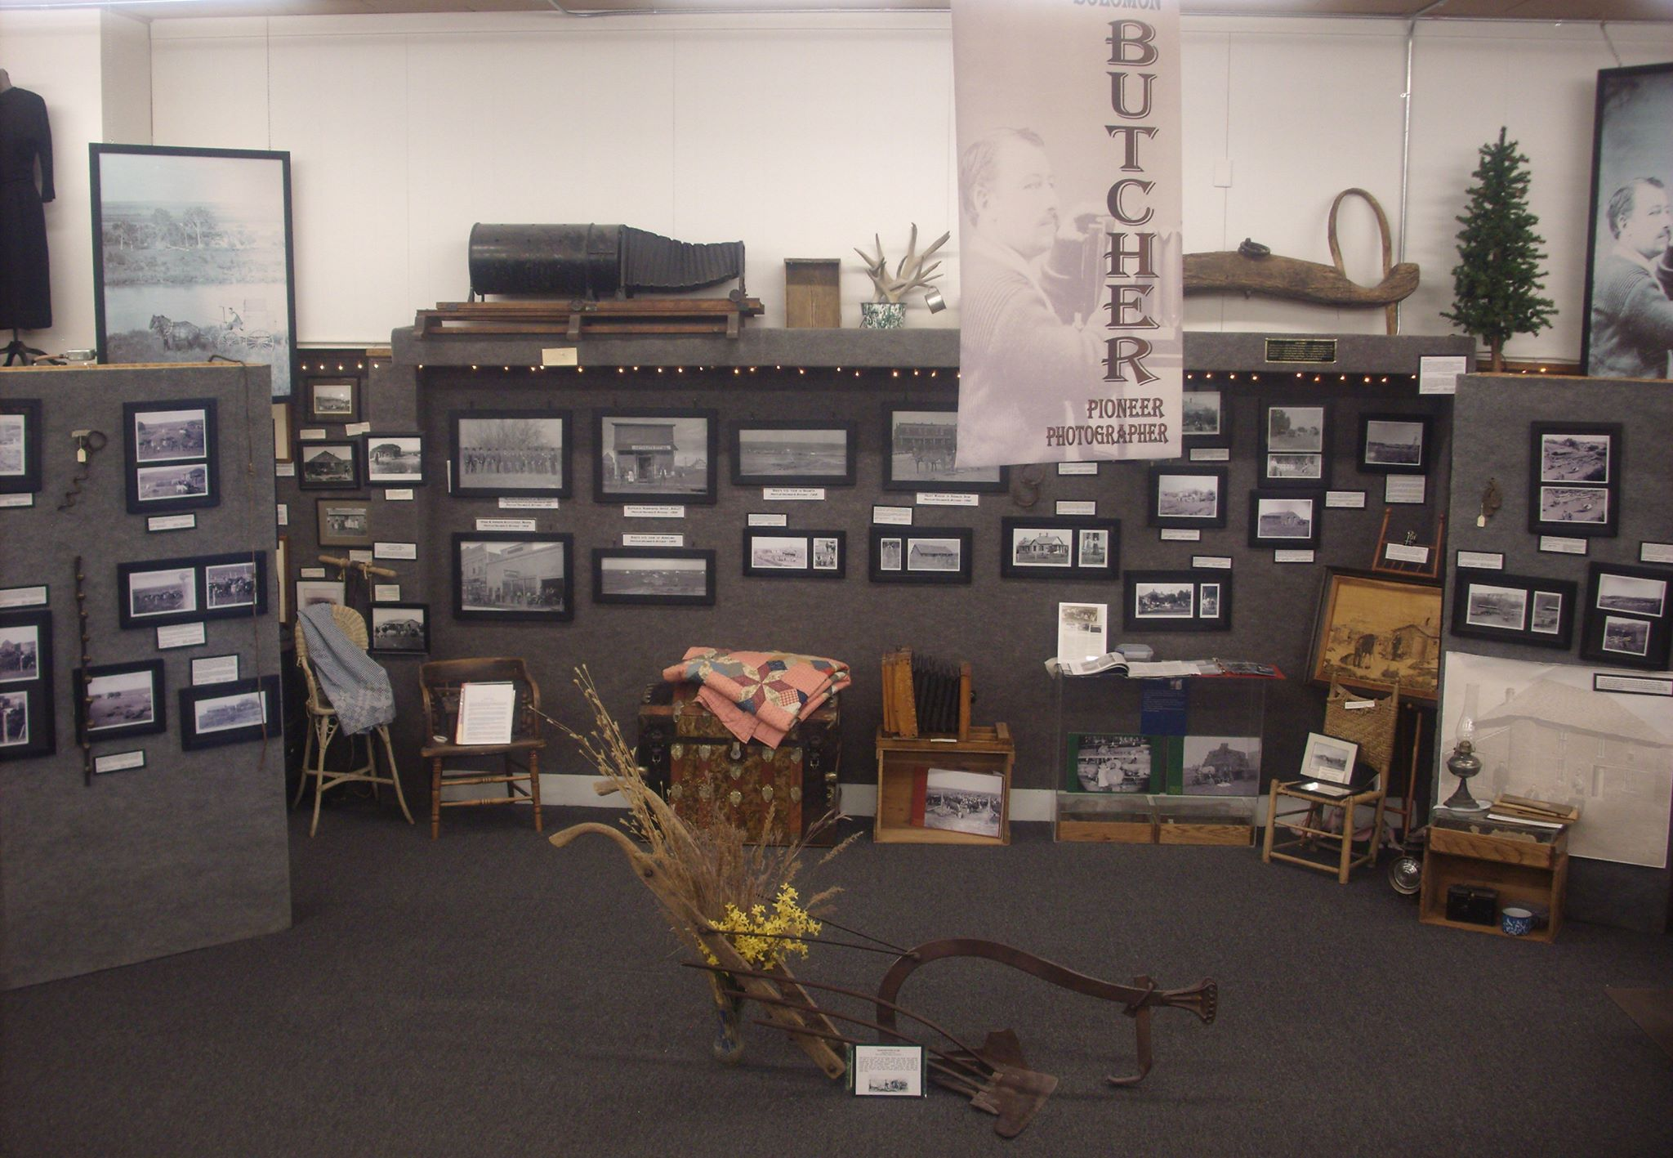
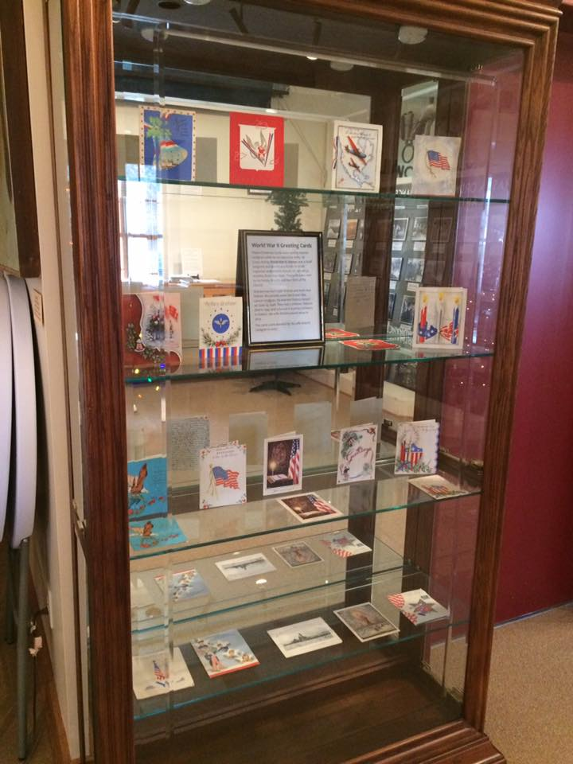
Notes:
Custer County Historical Society – lots of different items

Slide 67
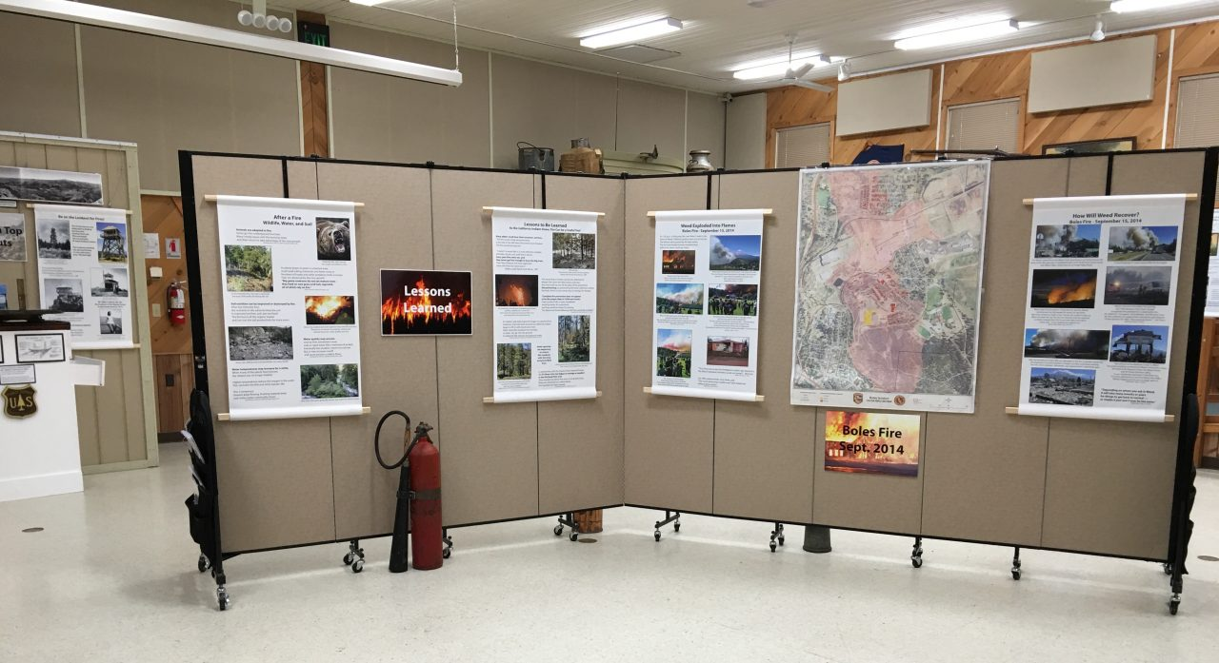
Notes:
Doesn’t have to be super expensive

Slide 68
What if I don’t have the funds, resources, or time to produce and install new text or photos?
Notes:
Don’t have the funds or resources for installing new text or photos? Tour guides can provide a wealth of historical interpretation

Slide 69
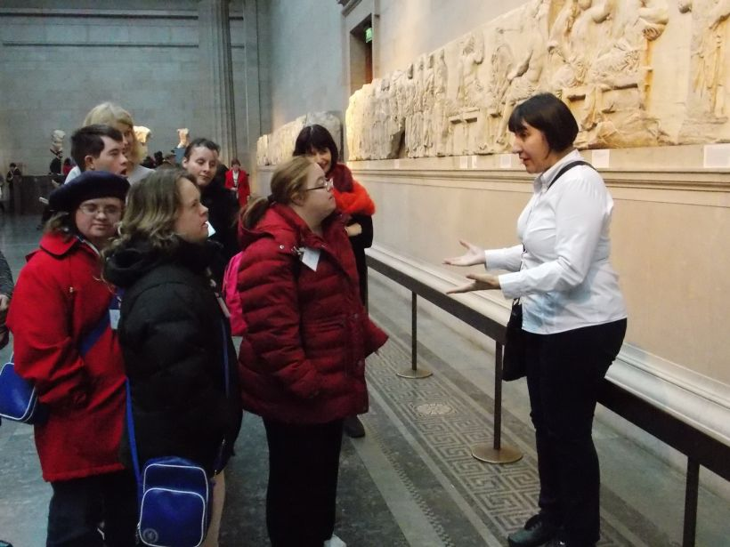
Notes:
Don’t have the funds or resources for installing new text or photos? Tour guides can provide a wealth of historical interpretation. YOU can be a wealth of historical interpretation.

Slide 70
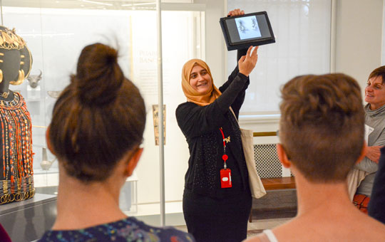
Notes:
Don’t have the funds or resources for installing new text or photos? Tour guides can provide a wealth of historical interpretation
They can utilize other materials during their tours, too

Slide 71
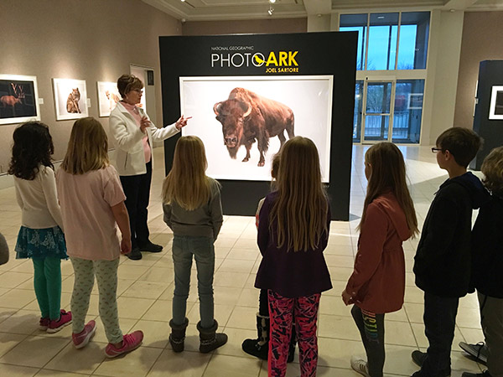
Notes:
Don’t have the funds or resources for installing new text or photos? Tour guides can provide a wealth of historical interpretation
Allow them to become “experts” in a given area- this will make them feel like they are contributing to your institution’s mission, that they are essential. Then they will relay that deep caring to your visitors. If they feel connected, they can help visitors feel connected.

Slide 73
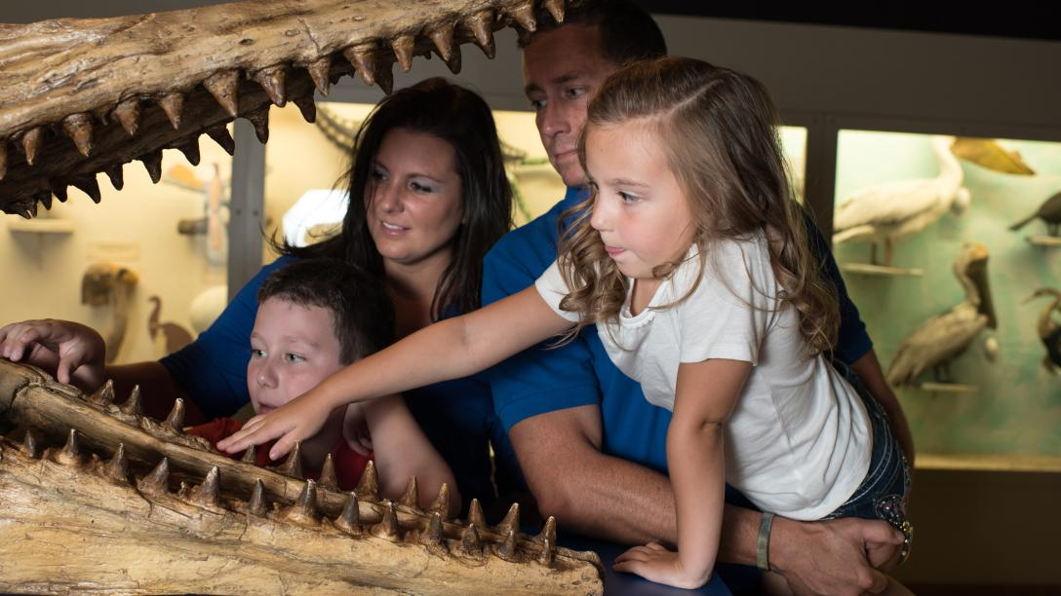
Notes:
Interactives

Slide 74
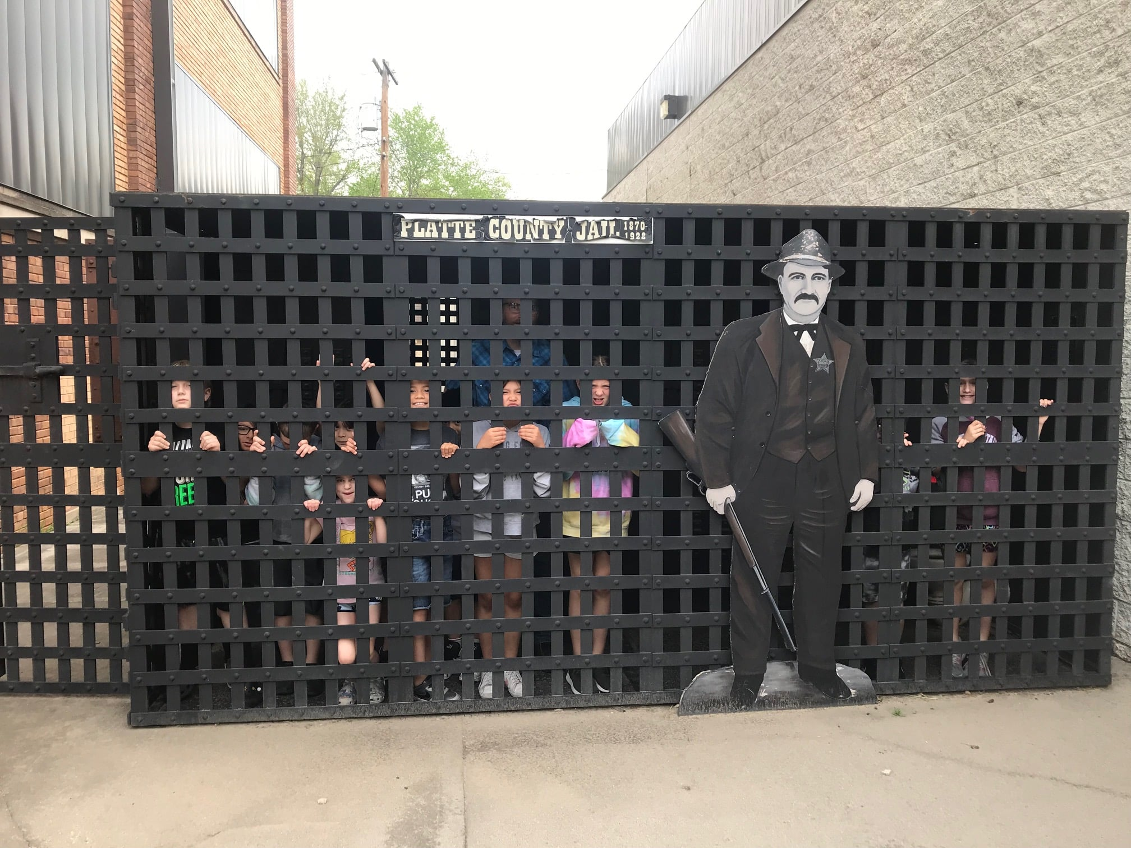
Notes:
Our host – Platte County Historical Society
Interactives – literal connections made. When connections are made, they can begin to interpret what their senses are experiencing

Slide 75
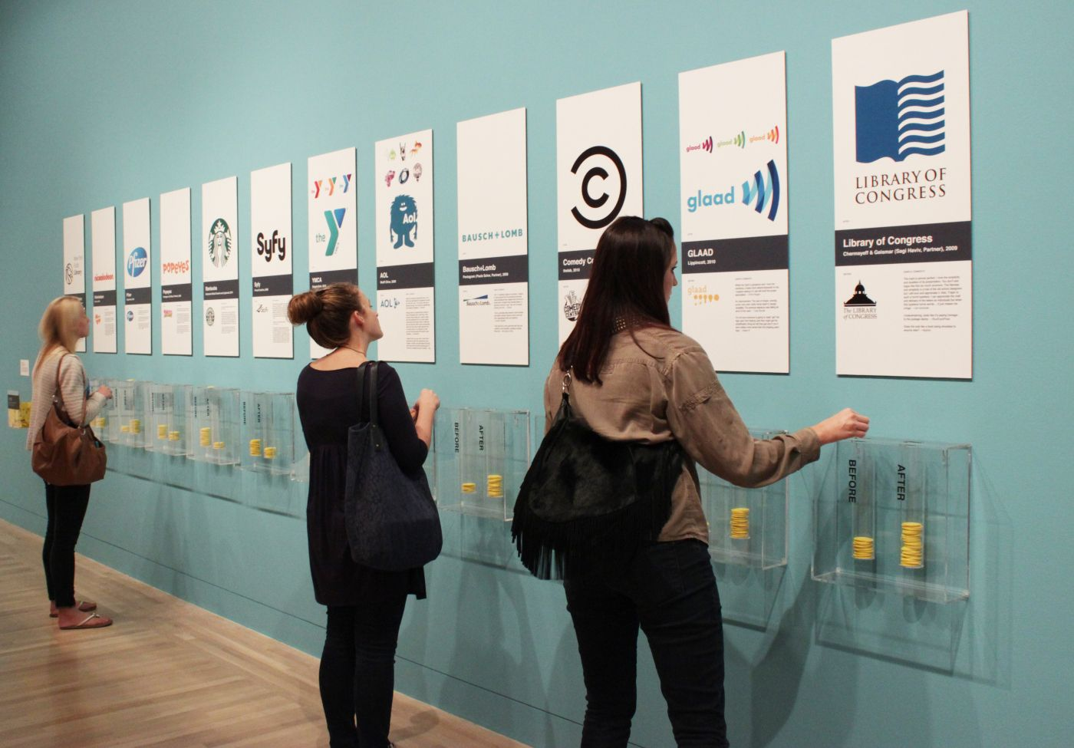
Notes:
Doesn’t have to be anything super complex- just ask visitors to participate in the history. When they participate, they begin to interpret the results of their interpretation

Slide 76
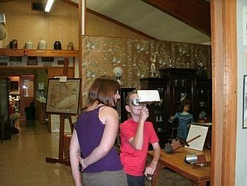
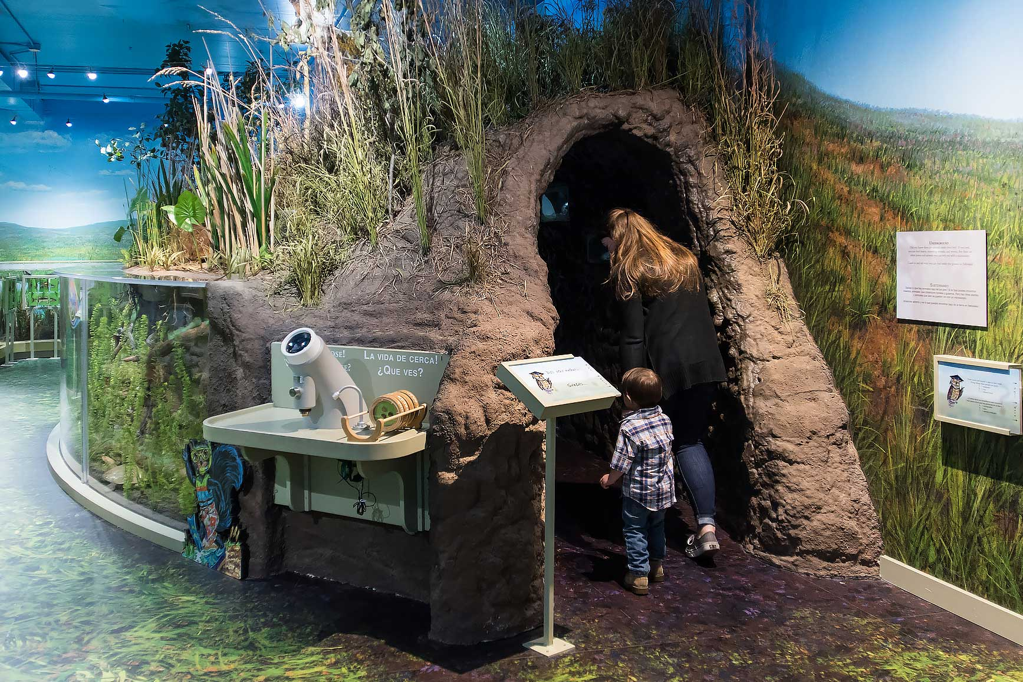
Notes:
Can be very involved or simple – places them within the history or subject
Nature nook at Hastings museum. Stereograph at Cass County Historical Society Museum
We use the building- our servant staircase

Slide 77
Notes:
So you have all your research, materials, and the aspects you want to focus on and how you’d like to historically interpret that focus, now it’s time to Collaborate

Slide 78
Collaborate, Cooperate, and Ask for Input
Notes:
So now the question- once you know what it is and why its important, how can you easily apply historical interpretation at your institution?

Slide 79
Collaboration is Essential to Successful Historical Interpretation
Notes:
How to relay a full interpreted message in a short amount of time or space?

Slide 80
Collaboration is Essential to Successful Historical Interpretation
Benefits from Multiple Perspectives
Notes:
Maybe they’ll see something you didn’t or will offer an interesting way to interpret your history

Slide 81
Collaboration is Essential to Successful Historical Interpretation
Benefits from Multiple Perspectives
Reach out to people in the community
Notes:
Maybe they’ll see something you didn’t or will offer an interesting way to interpret your history
What would they like to see? What are they interested in?

Slide 82
Collaboration is Essential to Successful Historical Interpretation
Benefits from Multiple Perspectives
Reach out to people in the community
Consider accessibility
Notes:
Maybe they’ll see something you didn’t or will offer an interesting way to interpret your history

Slide 83
Collaboration is Essential to Successful Historical Interpretation
Benefits from Multiple Perspectives
Reach out to people in the community
Consider accessibility
Consult with experts – NMA is always here for you!
Notes:
Maybe they’ll see something you didn’t or will offer an interesting way to interpret your history

Slide 84
Collaboration is Essential to Successful Historical Interpretation
Benefits from Multiple Perspectives
Reach out to people in the community
Consider accessibility
Consult with experts – NMA is always here for you!
Go to the source – if you’re unsure about any aspect, just ask!
Notes:
This can feel like the awkward part (depending on the group). But I can promise you it’ll be worth it- because the only thing more awkward than asking a potentially embarrassing question, is publishing something that receives negative feedback (that’s permanent reputation right there)
Imagine the script flipped- if someone was going to do a display on your family’s history, wouldn’t you want them to consult you?

Slide 85
Notes:
Collaboration eliminates the potential confusion, and allows for clearly communicating your historical interpretation
Reach out to others outside yourself to ensure your historical interpretation “makes sense”

Slide 86
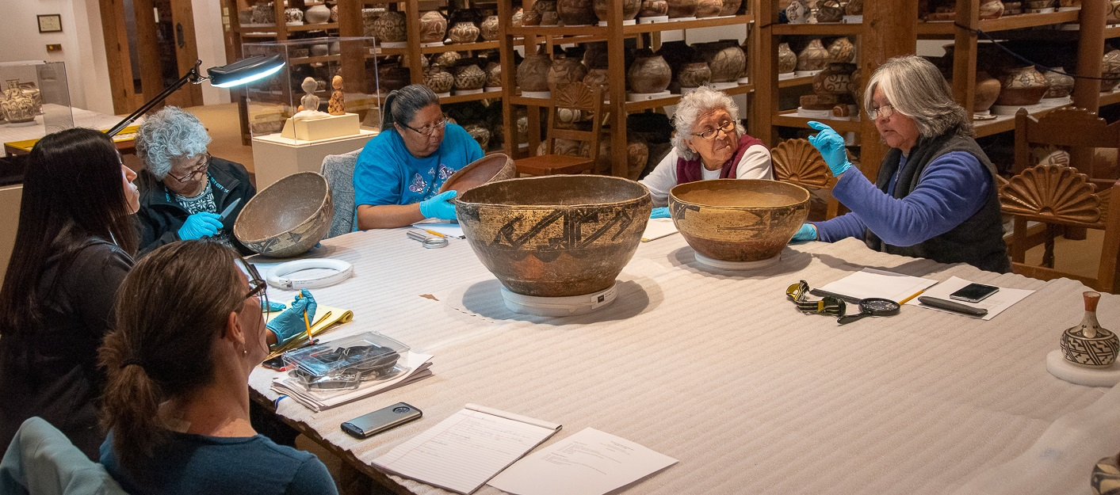
Notes:
Collaboration with specific groups builds trust and good, lasting relationships
Pueblo pottery with pueblo tribal members

Slide 87
Notes:
Be willing to challenge your own thoughts – NEVER ASSUME
It may feel awkward at first, but I can promise that 99% of the time it will be rewarding, and the group you talk to will thank you for it

Slide 88
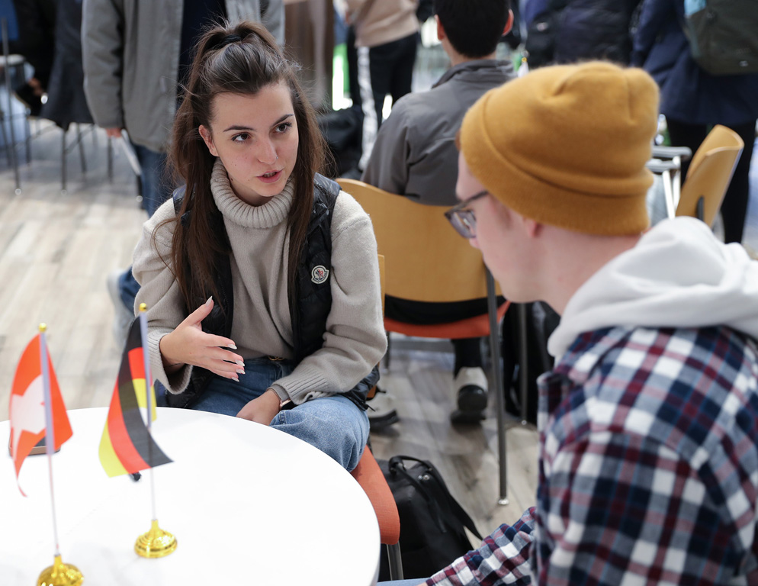
Notes:
Be willing to challenge your own thoughts – NEVER ASSUME
It may feel awkward at first, but I can promise that 99% of the time it will be rewarding, and the group you talk to will thank you for it
I do it all the time with UNK’s ODI – you’re also welcome to contact them any time!

Slide 89
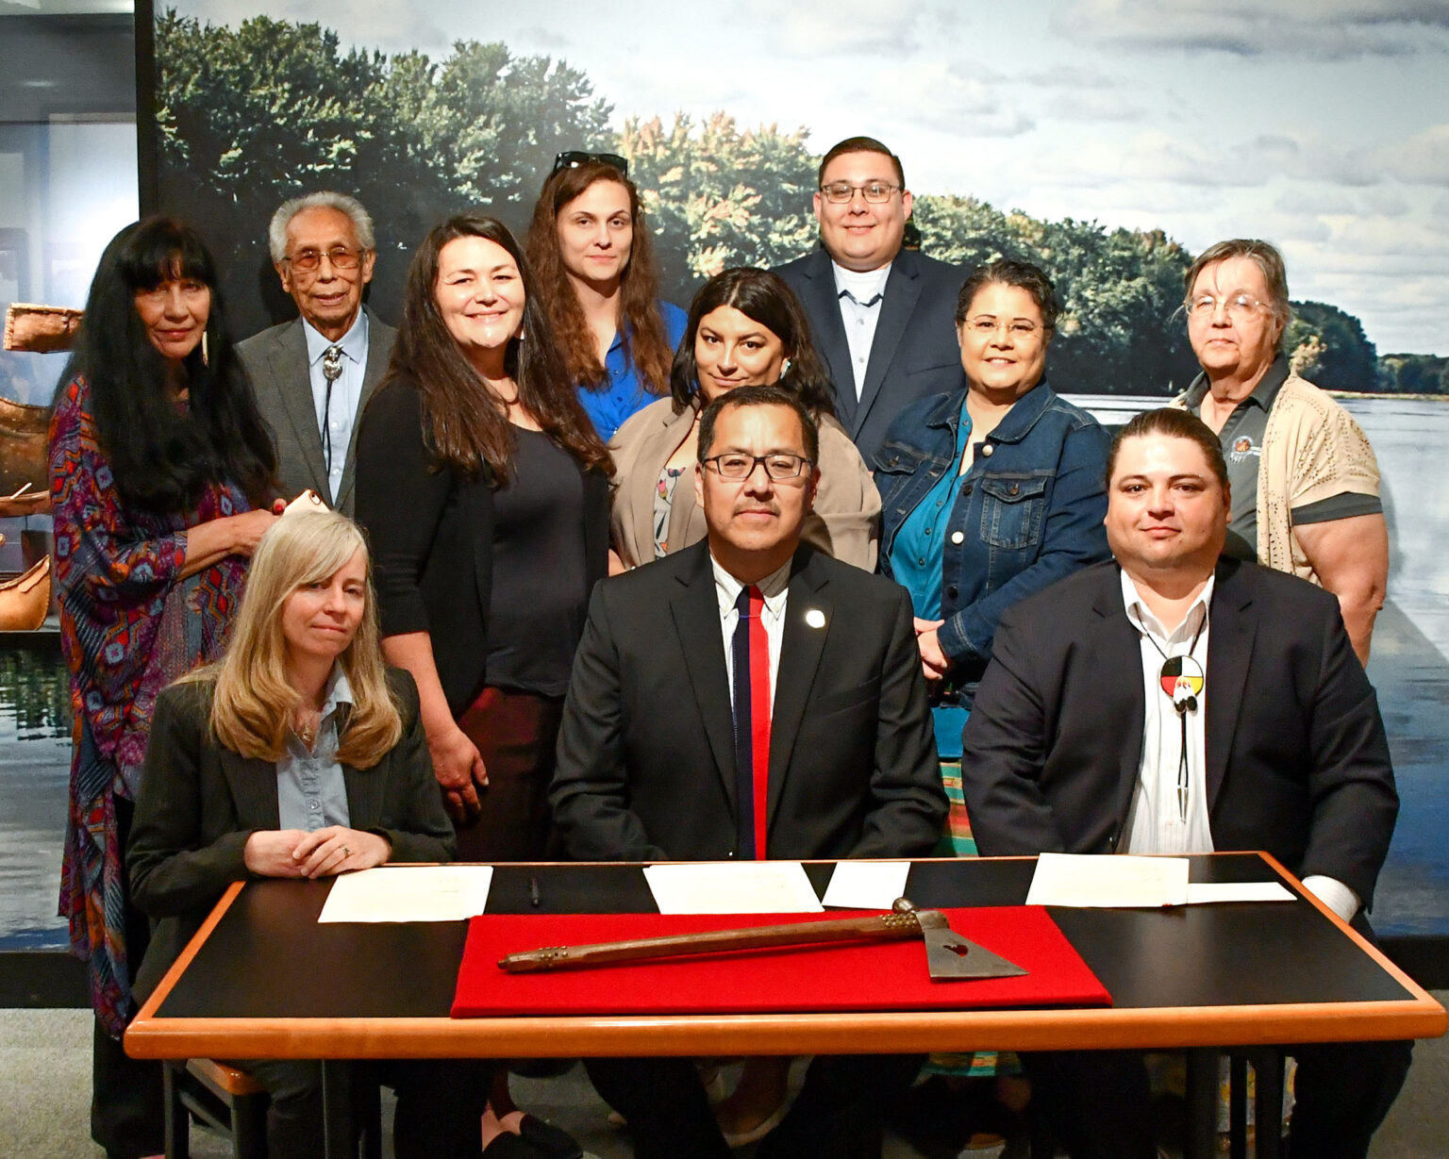
Notes:
So many marginalized groups had been neglected from the conversation for so long, they will absolutely appreciate it.
Peabody Museum of Archaeology and Ethnology at Harvard University.
June 3rd ceremony at the Museum, attended by delegations from the Ponca Tribe of Nebraska and the Ponca Tribe of Oklahoma, the pipe-tomahawk was returned to the Tribe. Rebuilding trust and lasting relationships
Also- the way this tribe historically interprets this tomahawk is much different than those who are not part of a native indigenous tribe

Slide 90
Produce and Promote
Notes:
So now the question- once you know what it is and why its important, how can you easily apply historical interpretation at your institution?

Slide 91
Produce and Promote
Use social media, write a press release
Work with local high school students, college students
Talk to local print shops
Grants for production
Rule #1: Always keep the Historical Interpretation front and center
Notes:
Maybe they’ll see something you didn’t or will offer an interesting way to interpret your history

Slide 92
Examples from the G.W. Frank Museum of History and Culture
Notes:
Now we’re going to get into some real-world examples that I’ve seen have great, effective success

Slide 94
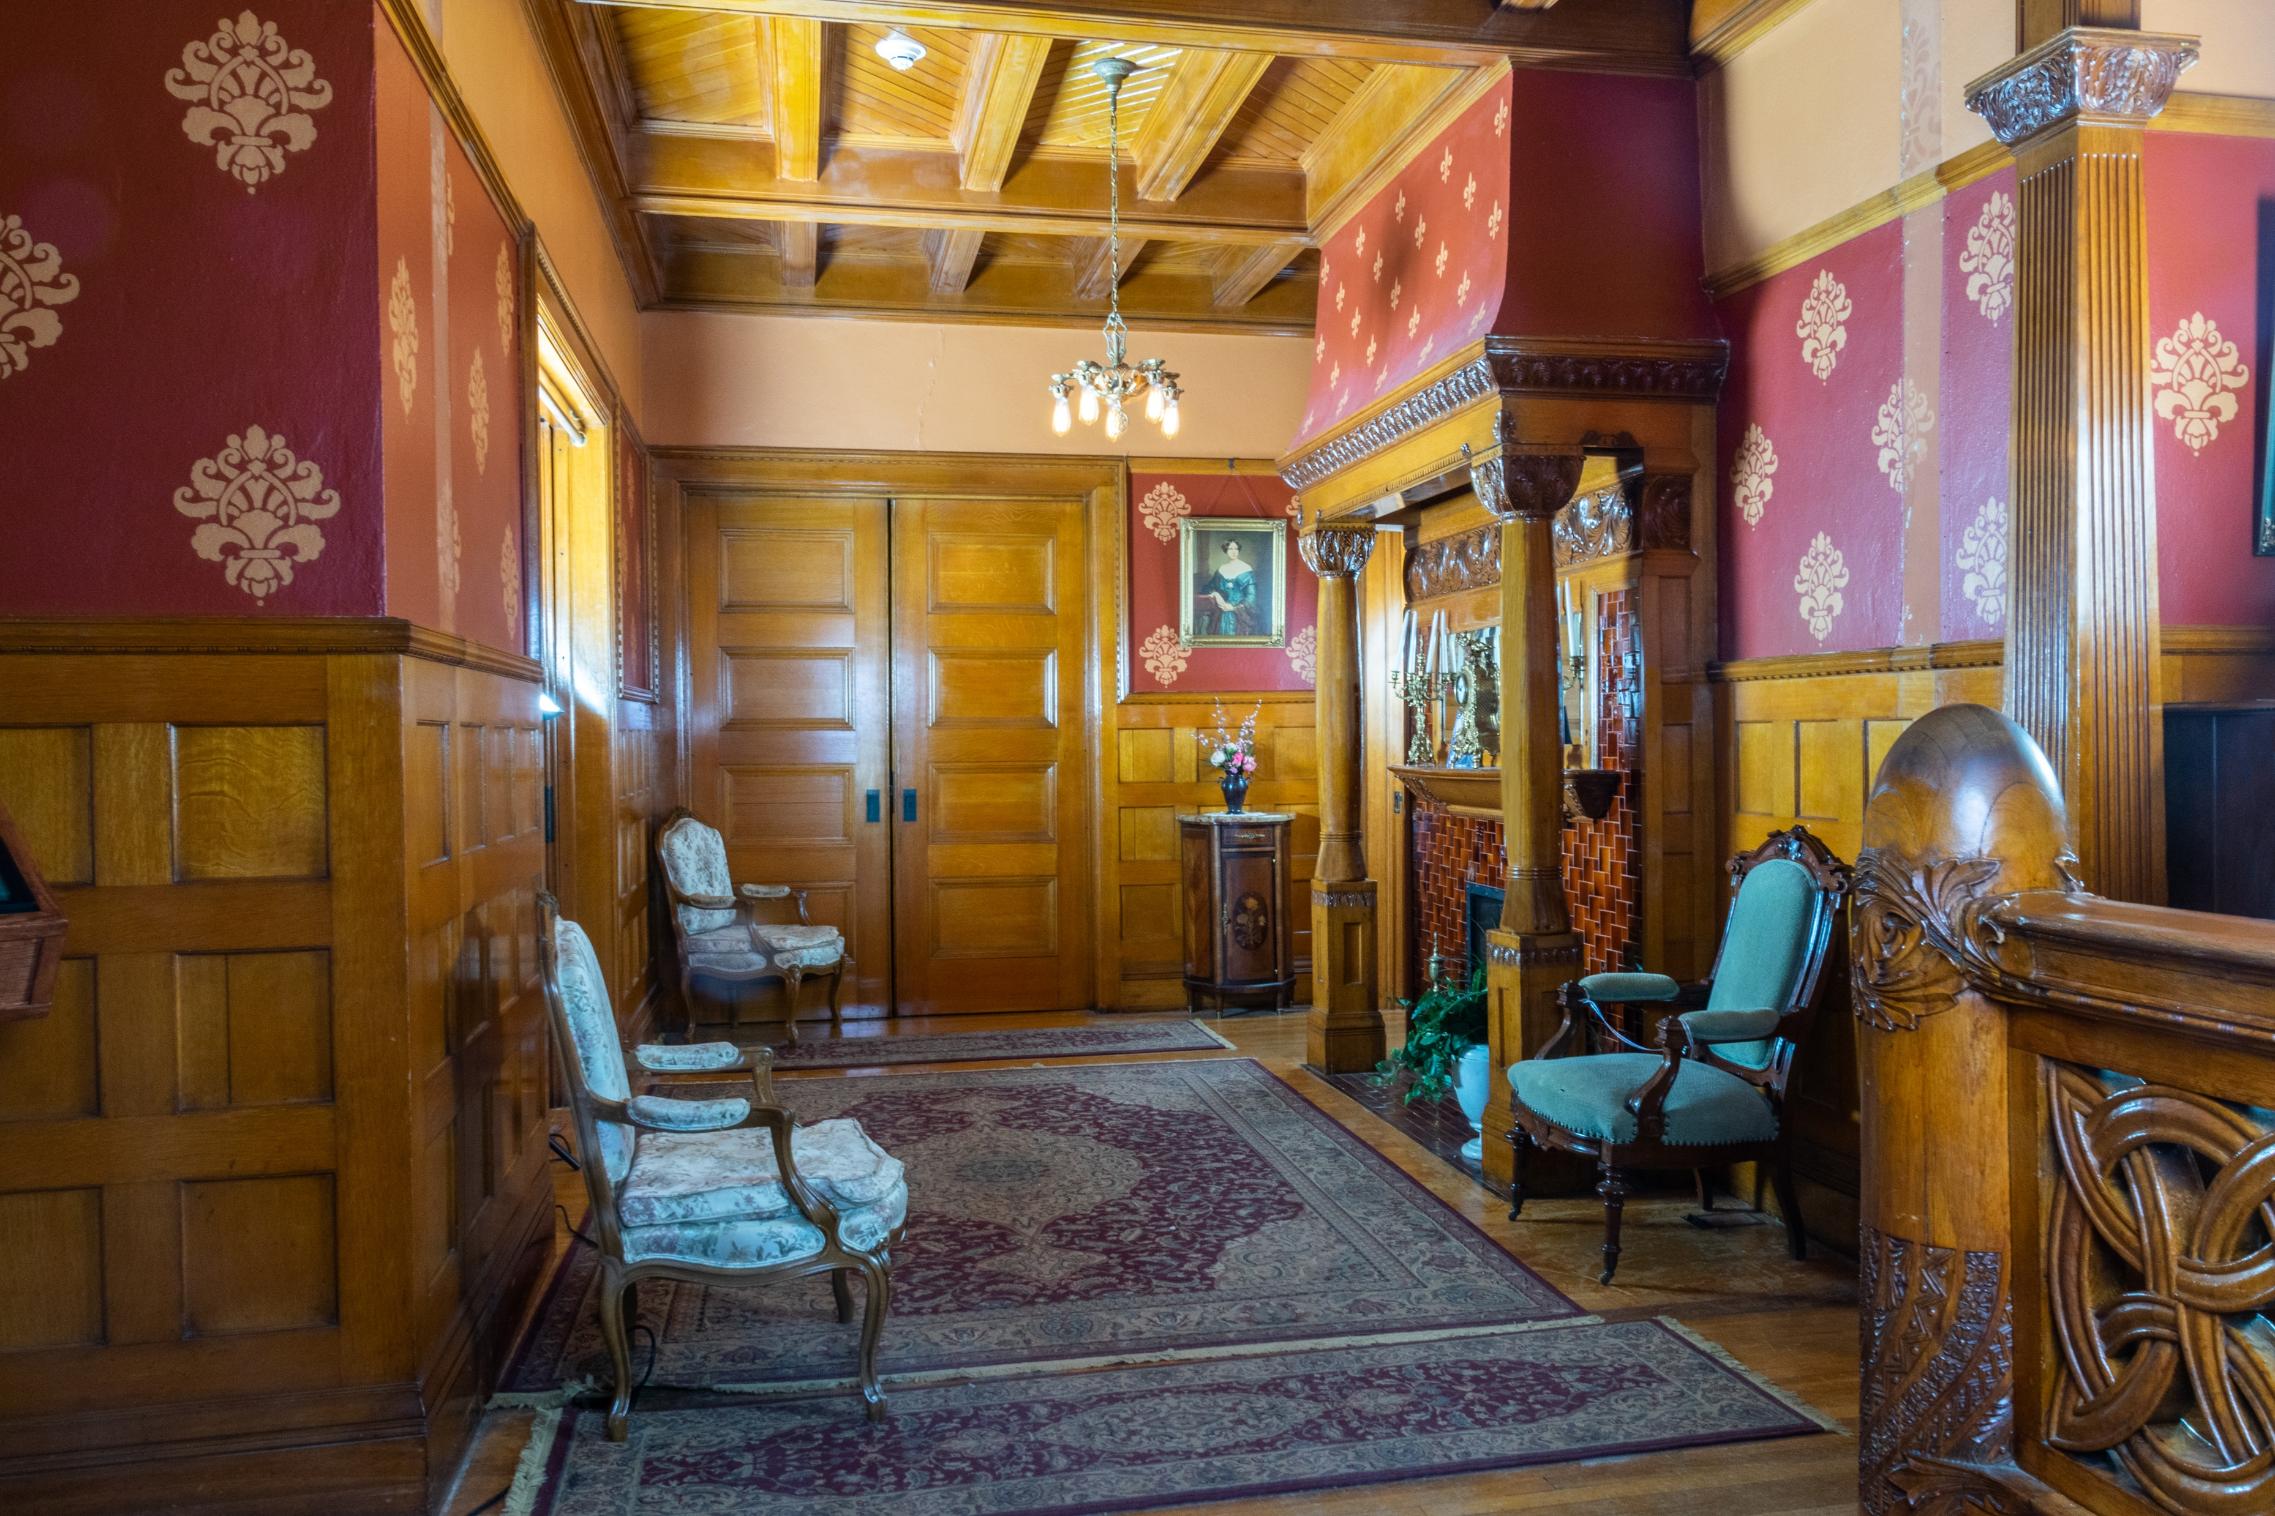
Notes:
Again- we use our actual building to provide interactive history and create a living space for interpreting our history

Slide 95
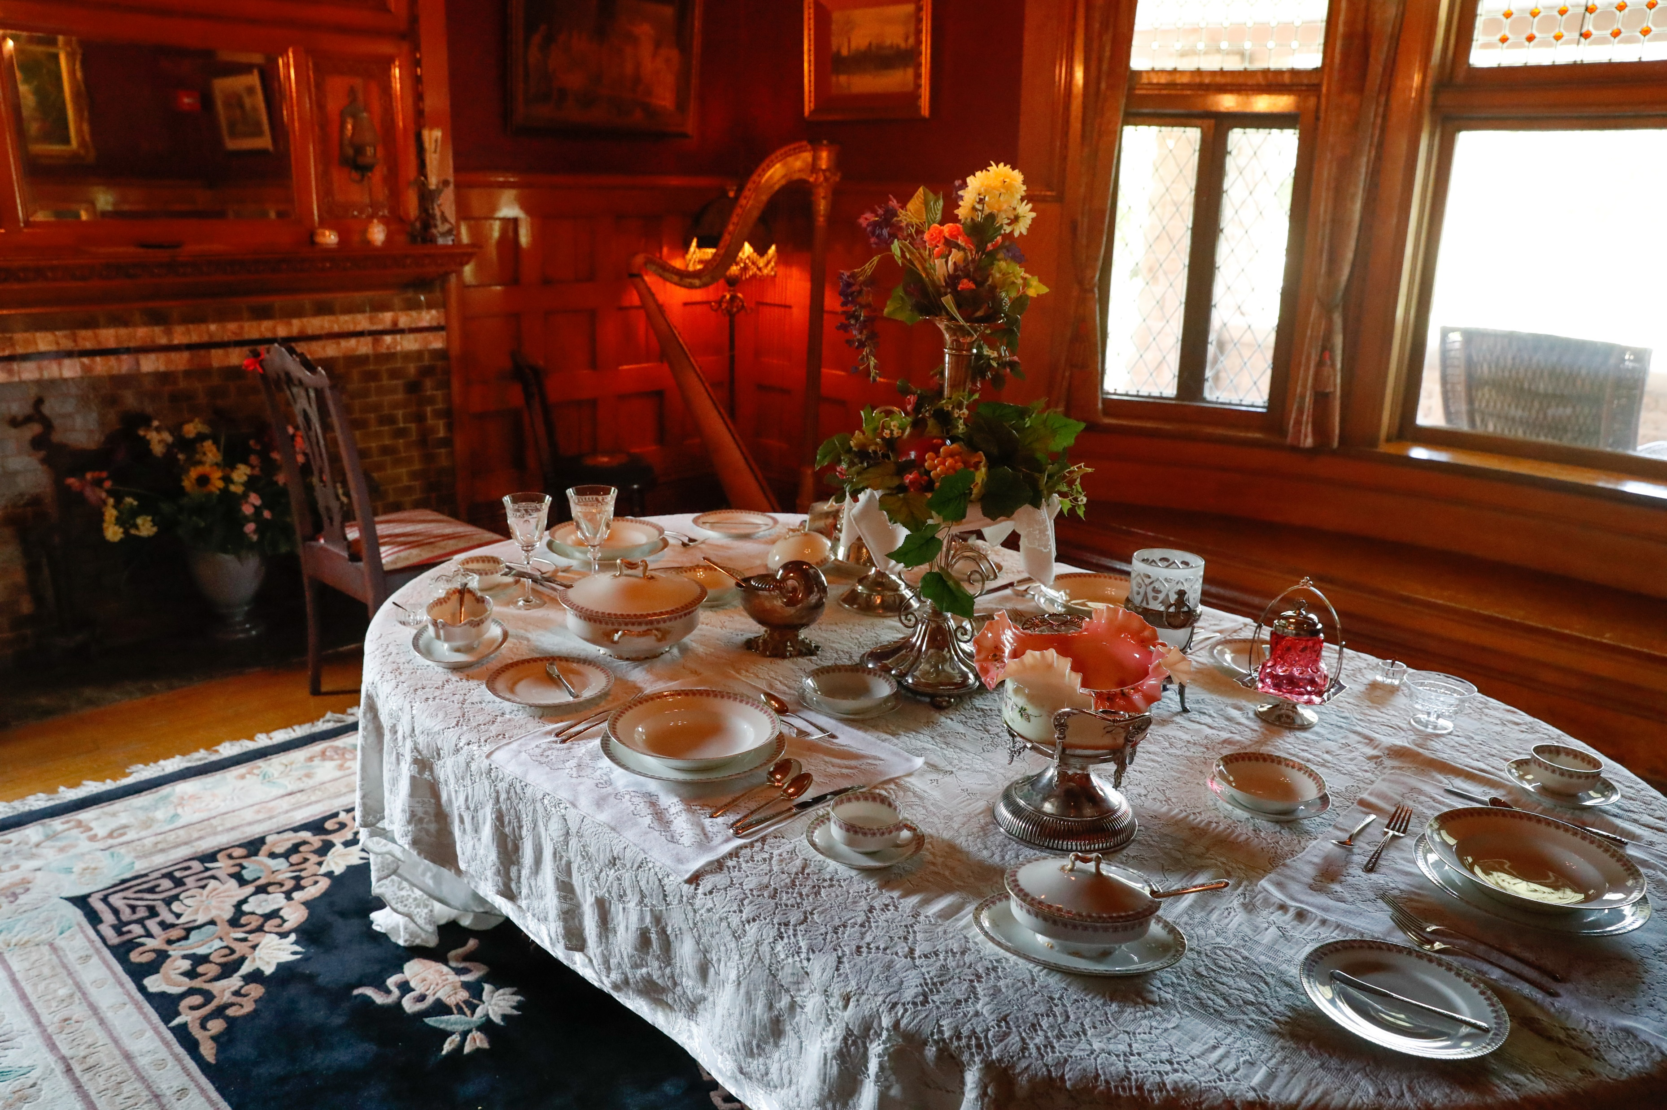
Notes:
Again- we use our actual building to provide interactive history and create a living space for interpreting our history

Slide 96
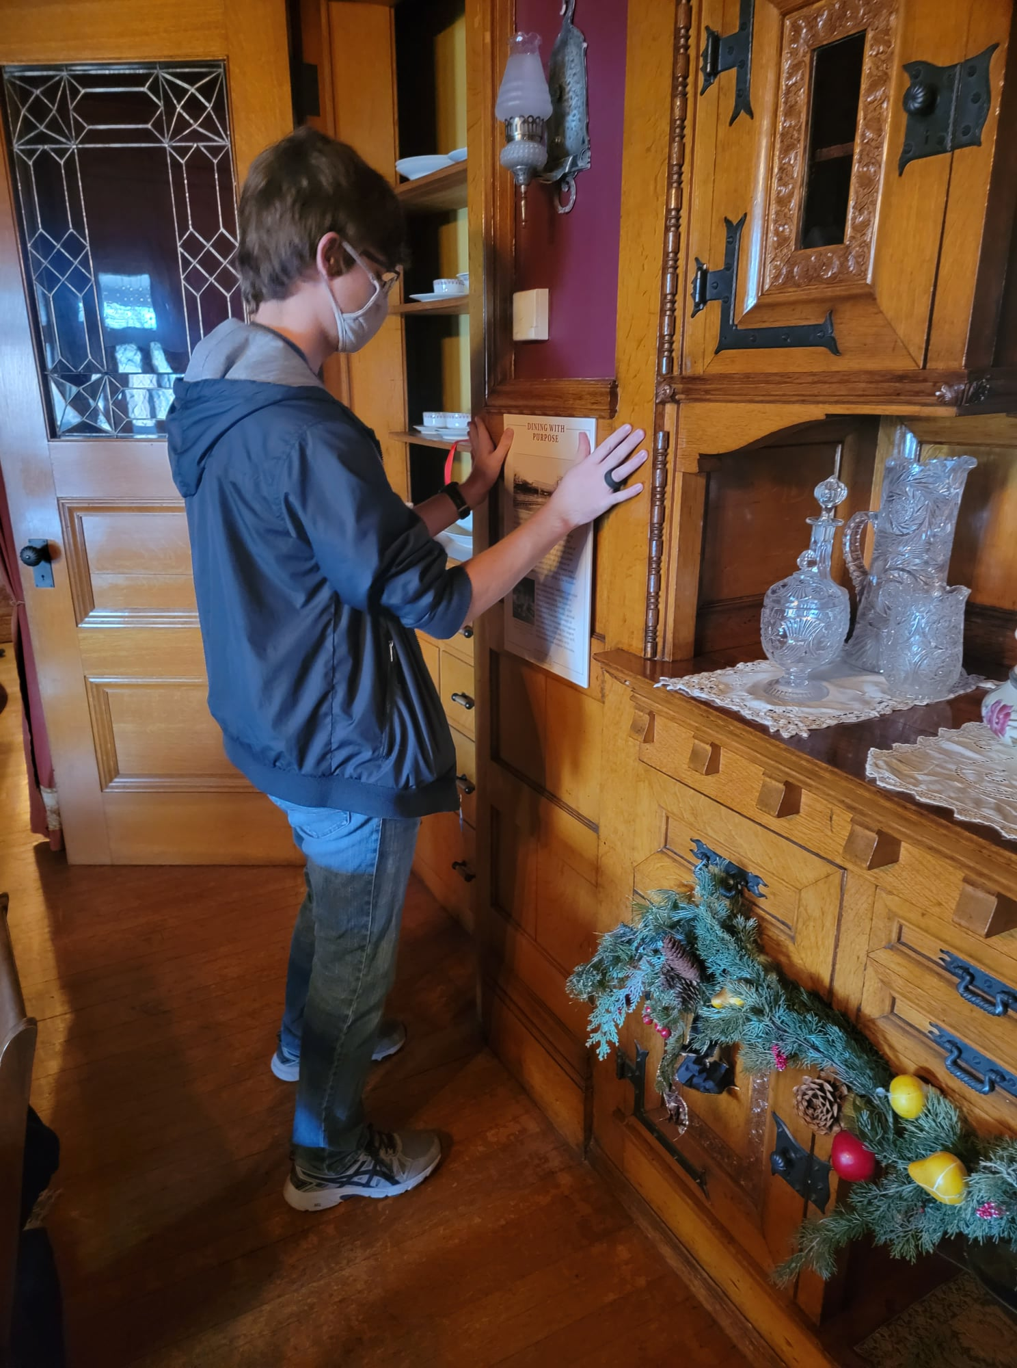
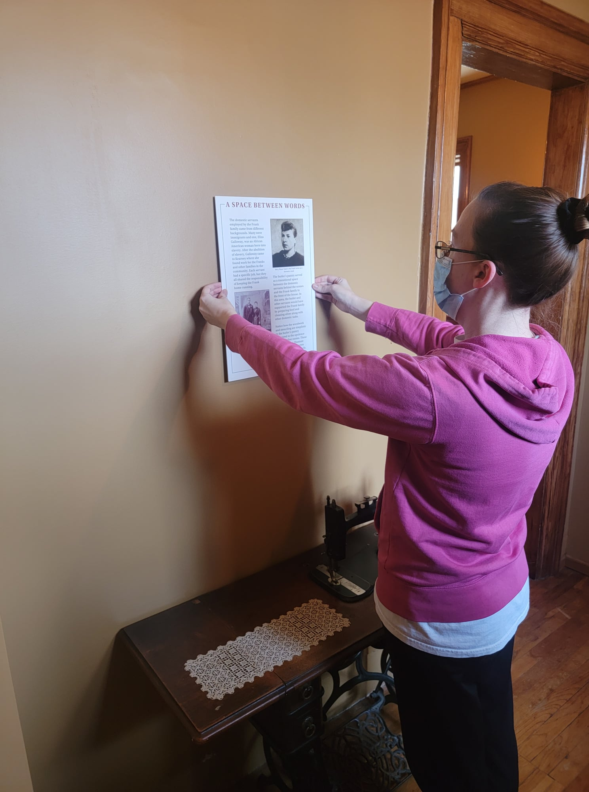
Notes:
Again- we use our actual building to provide interactive history and create a living space for interpreting our history

Slide 97
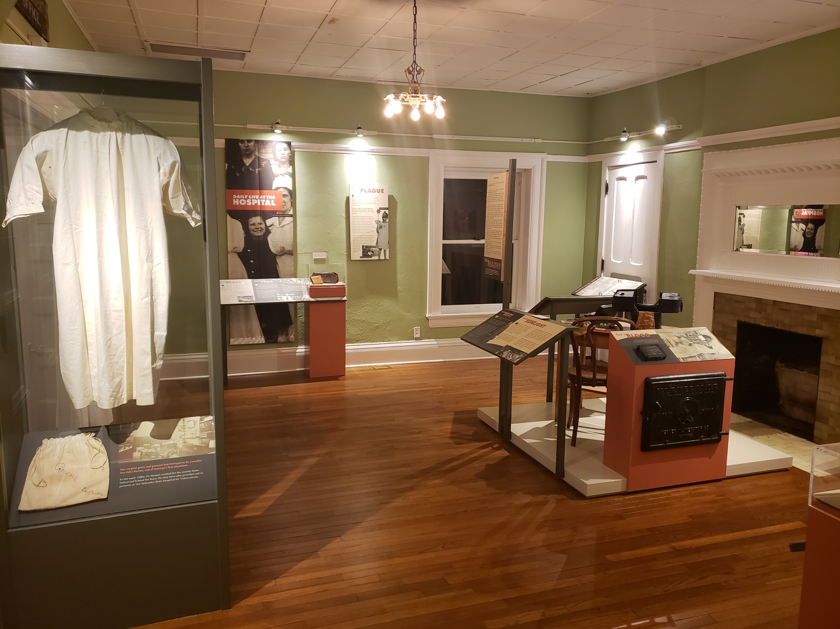
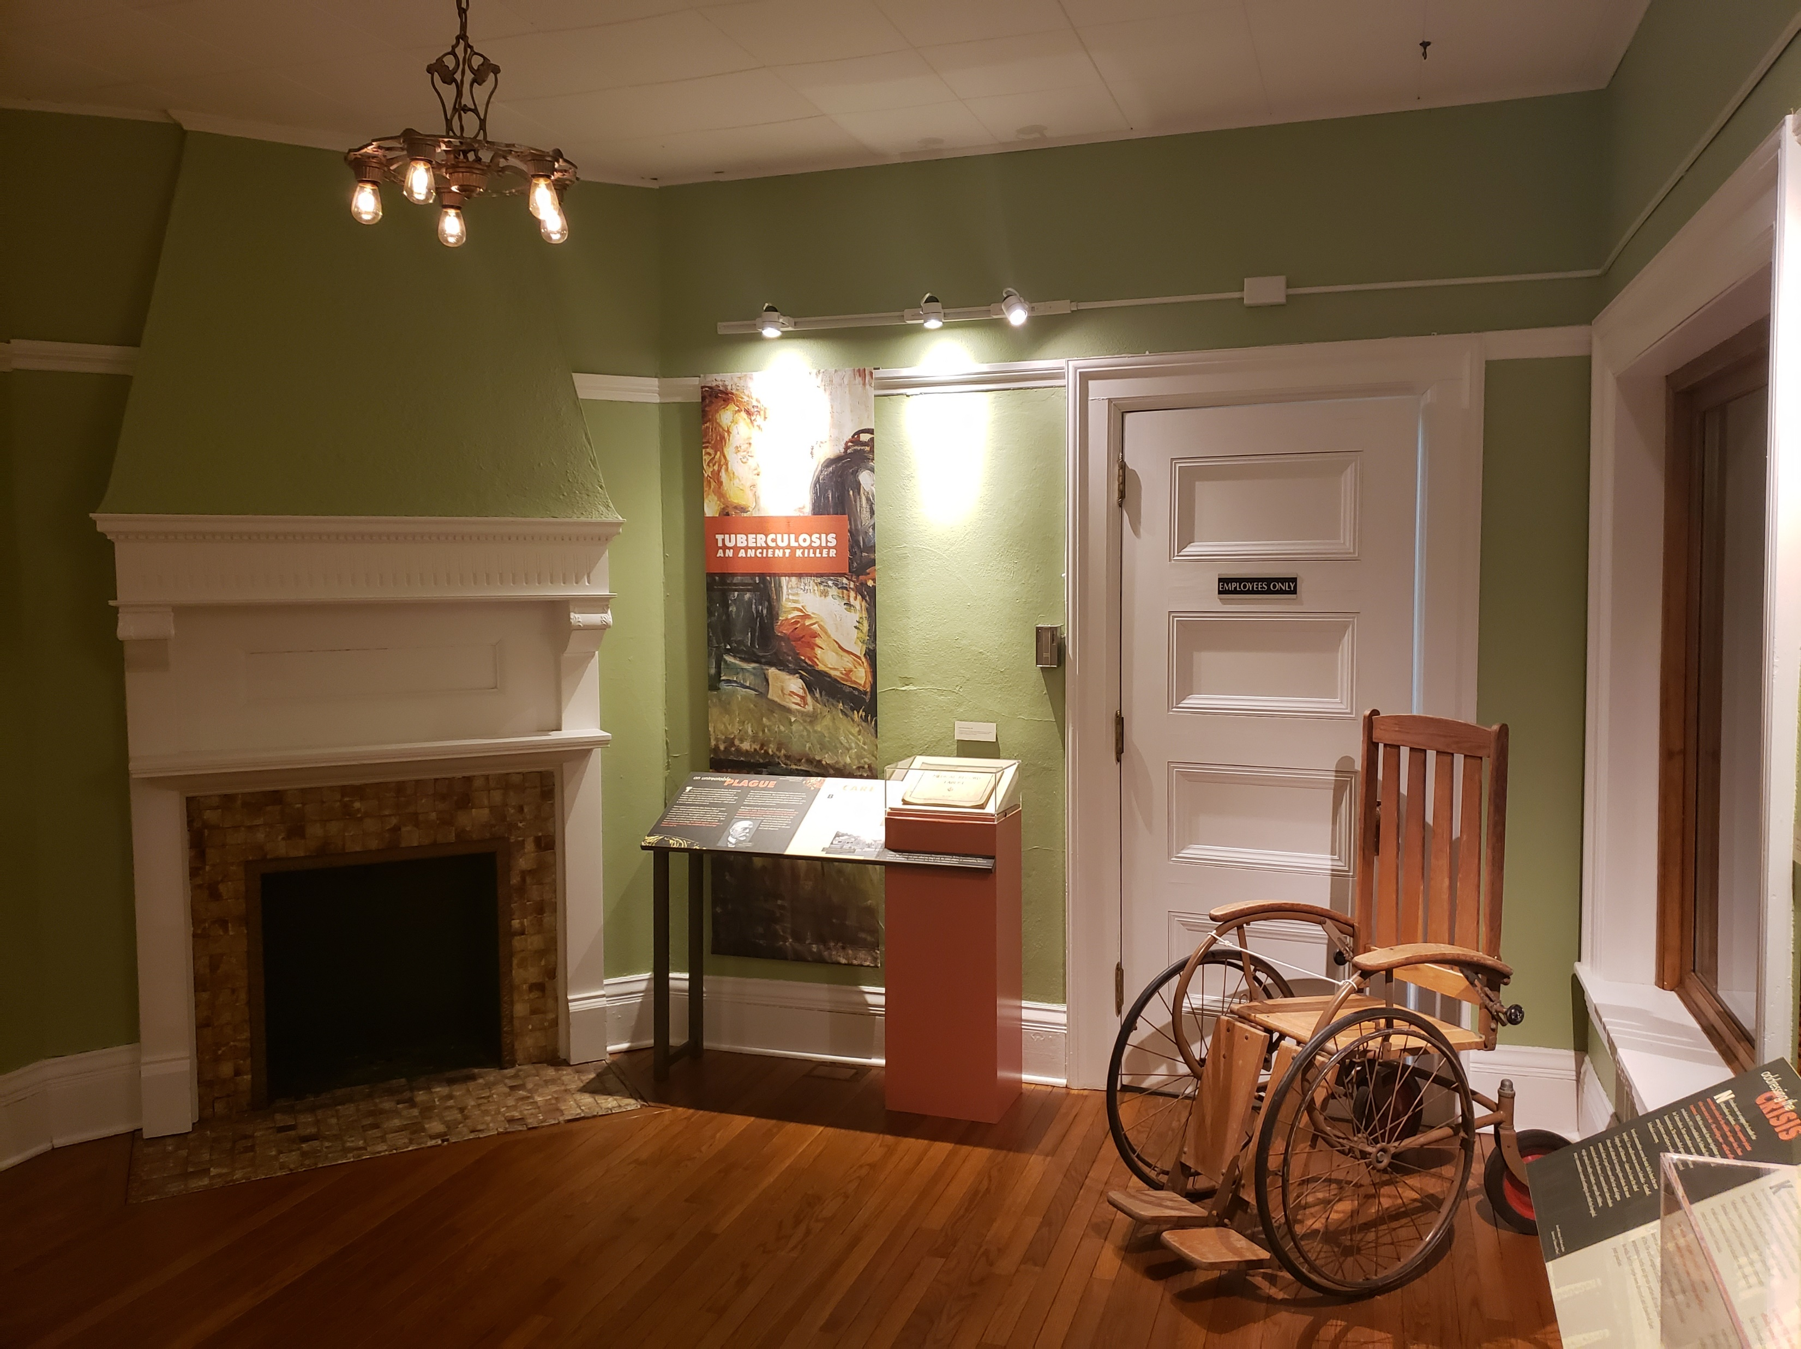
Notes:
We also offer a variety of exhibits with different styles, themes, materials

Slide 98
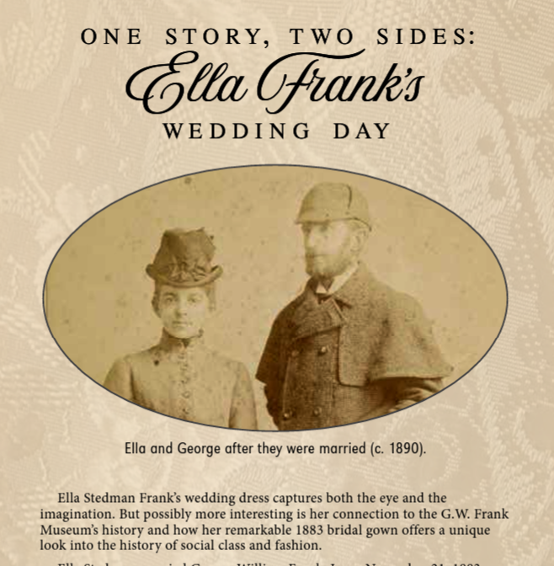
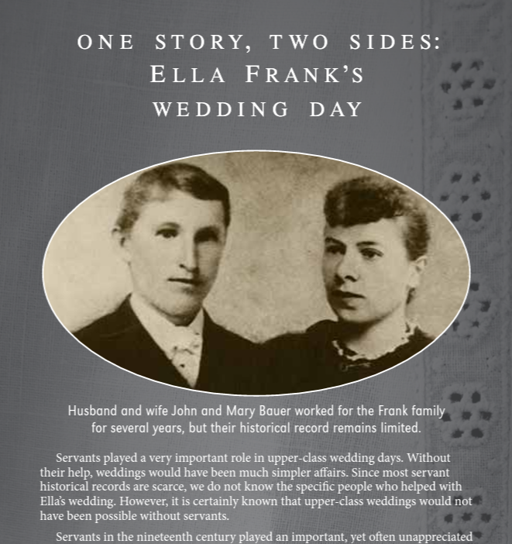
Notes:
Multiple perspective interpretation

Slide 99
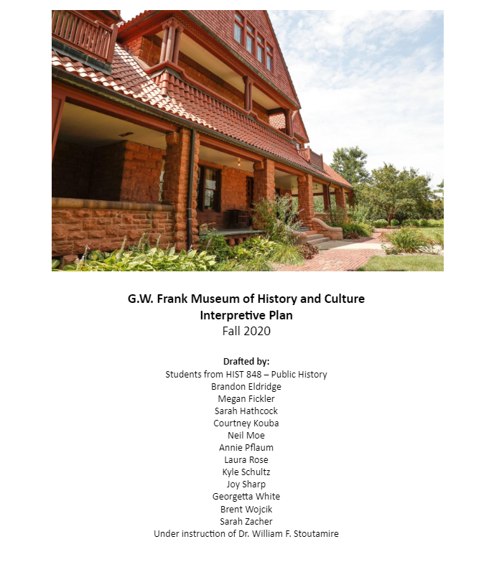
Notes:
Few years ago, we created our own interpretation plan – happy to share this with anyone who wants it

Slide 100
Notes:
Few years ago, we created our own interpretation plan – happy to share this with anyone who wants it

Slide 101
Additional Resources
Nebraska Museums Association
University of Nebraska at Kearney History Department
History Nebraska
American Alliance of Museums MAP Assessment
American Alliance of Museums Education and Interpretation Standards
YouTube, books, articles, etc.

Slide 102
Historical Interpretation:
Notes:
Once again---
A verb, always changing. Allow yourself grace, time to learn, time to familiarize

Slide 103
Historical Interpretation:
The act or result of explaining or interpreting history; the way the past is explained or understood.
For museums and historic sites --
Creating meaningful histories from our collections and research, and effectively communicating those histories to our visitors.
Notes:
Once again---
A verb, always changing. Allow yourself grace, time to learn, time to familiarize

Slide 104
Thank you and have fun with your Historical Interpretation!
Special Thanks to:
Nebraska Museums Association Conference Committee
Our Conference Sponsors
City of Columbus and the Ramada Inn
All our attendees
“History Without Meaning Just Isn’t Worth Doing: How to Apply Historical Interpretation at Museums and Historic Sites,” 2023 Nebraska Museums Association Conference
April White, Director at the G.W. Frank Museum of History and Culture
Phone: (308) 865-8273
Email: whiteac@unk.edu

